Slide 1
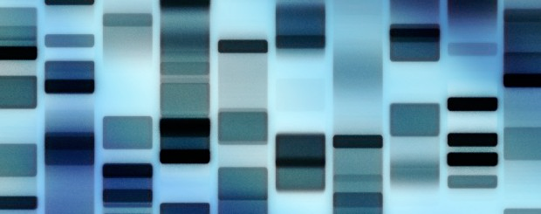
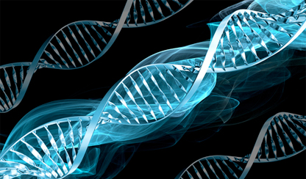
Genetics
BIO 1103 Winter 2015 February 11, 2015

Slide 2
learning Objectives
Conceptualize genetic diversity & its linkages with DNA, RNA & proteins
Examine genetic and species diversity as genotypes & phenotypes
Recognize gene variability through alleles
Define heterozygous, homozygous, dominant, recessive & epigenetics in relation to genetics & diversity
Predict inherited genotypes and phenotypes

Slide 3
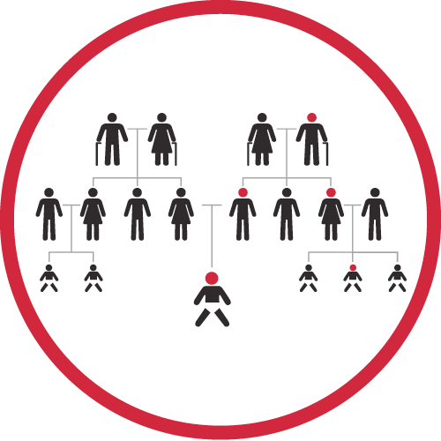
Genetics
Study of heredity - explains how characteristics are passed onto offspring
Based on DNA
Integral to biodiversity, GMOs, evolution & modern agriculture & medicine
http://healthsciences.utah.edu/utah-genome-project/family/2013/following_the_family_tree.php

Slide 4
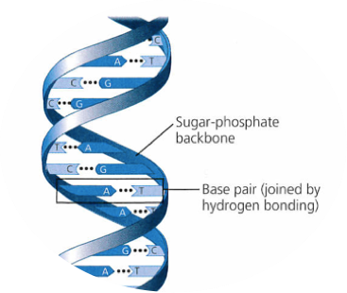
DNA
Deoxyribonucleic acid - self-replicating, nucleic acid
Molecule of cellular information & inherited genetic material
  Double helix of:
    Sugar-phosphate backbone
    4 nitrogenous bases
      Adenine (A)
      Thymine (T)
      Guanine (G)
      Cytosine (C)
Biology.

Slide 5
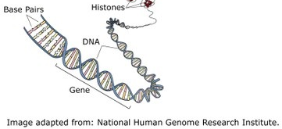
DNA
  Genotype - organism’s DNA sequence of As, Ts, Gs, & Cs
  Gene - DNA sequence which encodes a protein
    Unit of evolution & inheritance
    All an organism’s genes = genome
  Phenotype - combination of an organism’s observable traits produced by its genotype

Slide 6
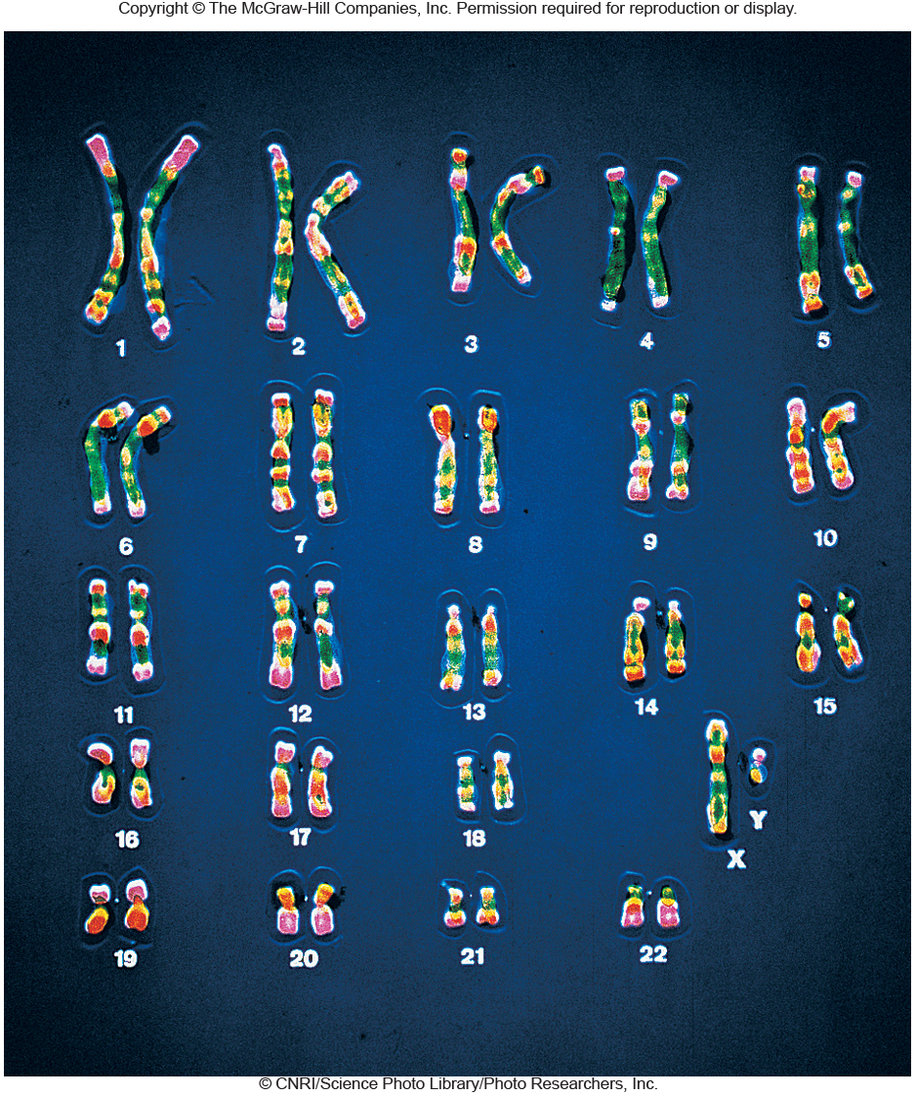
Chromosomes
Organizational & compaction units for DNA
Each chromosome contains 1000s of genes (alleles)
Diploid: 2 copies of each chromosome
Haploid: 1 copy of each chromosome, gametes & prokaryotes

Slide 7
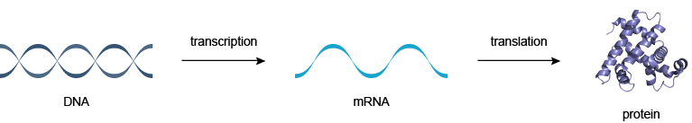
Central Dogma of biology
Every DNA base transcribed into a messenger RNA (mRNA) base (1:1)
Every 3 mRNA bases = codon translated into one amino acid (3:1)
Chain of amino acids = protein
Protein functions & combinations = organelles

Slide 8

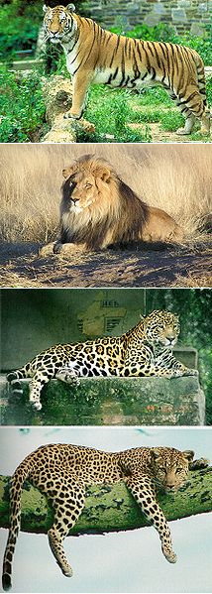
Species
Organisms which
  share same DNA & characteristics
  can interbreed to produce fertile offspring
3-5 million eukaryote species worldwide (plants & animals)
Unknown number of prokaryote species (bacteria & archaea)
VeronicaPR at en.wikipedia

Slide 9
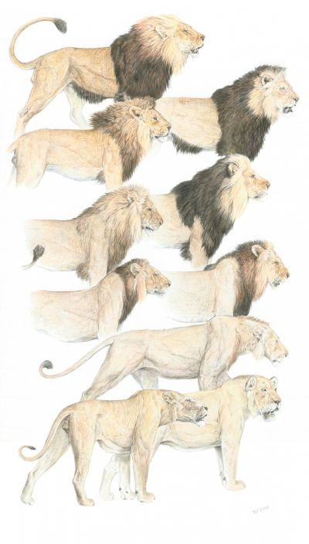
Genetic diversity Within a Species
East African Lion Coat Variations
Variations in DNA sequence within a species
  Sequence of Base pairs or Genes
  Different Forms of a Gene = Alleles
Creates variations in traits = Phenotypes
Every organism has slightly different set of alleles from their unique DNA sequence = basis of all biodiversity & evolution
By Color plate by Velizar Simeonovski (http://www.eurekalert.org/multimedia/pub/1943.php) [CC-BY-3.0 (http://creativecommons.org/licenses/by/3.0)], via Wikimedia Commons

Slide 10
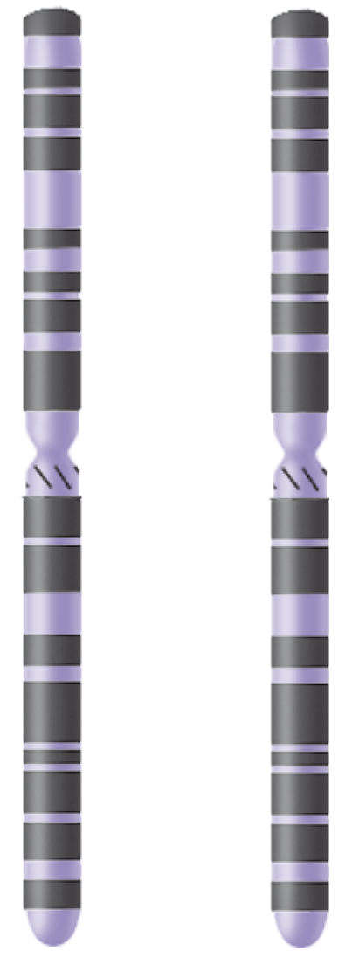
alleles
Different forms of the same gene carried on different chromosomes or different locations in genome
Alleles arise from:
  Mutation - random DNA errors
  Sex - recombines & reorganizes DNA
Homologous chromosomes
(one homolog is from the father
and the other from the mother)
Locus (the part of a
chromosome where a gene
is located)
A
a
Alleles (different forms of
a gene at a gene locus,
often denoted by letters,
such as A or a)
Copyright © The McGraw-Hill Companies, Inc. Permission required for reproduction or display.

Slide 11
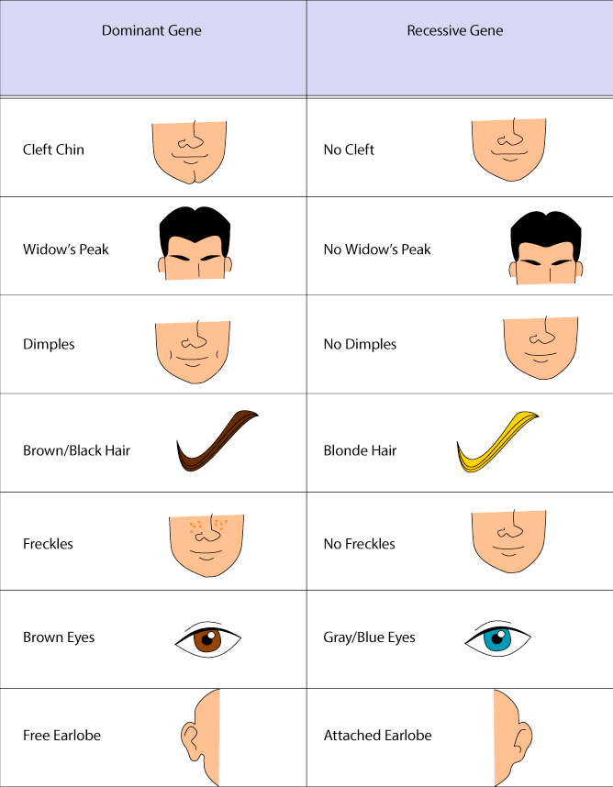
Dominant & Recessive Alleles
Dominant: allele that is always displayed in phenotype (A)
Recessive: allele that is masked in phenotype (a) (sickle cell anemia)
Codominance: some alleles are not entirely dominant & recessive (blood type)
Polygenic traits: traits are controlled by more than one allele (eye & hair color)

Slide 12
Chromosomes + Alleles
Homozygous: Two of the same alleles for a trait
  Homozygous dominant: AA
  Homozygous recessive: aa
Heterozygous: One dominant & one recessive allele for a trait
  Heterozygous: Aa

Slide 13
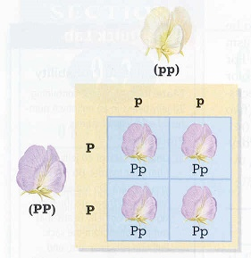
Mendelian Genetics
Eukaryotes receive one chromosome from each parent
  One allele from mom + one allele from dad = offspring genotype
  Offspring genotype based on chance, but follows predictable statistics - Punnett Squares
Homozygous recessive - white flower
All offspring heterozygous-
purple flowers
Homozygous dominant - purple flower

Slide 14
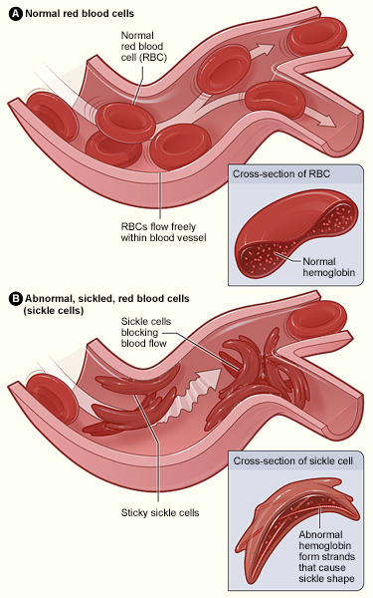
Sickle-cell anemia
Example of homozygous & heterozygous interactions with dominance
Homozygous dominant (SS) - normal red blood cells
Homozygous recessive (ss) - sickle cell anemia
Heterozygous (Ss)- sickle cell trait; partial anemia but reduced malaria; carriers favored by natural selection
http://www.nhlbi.nih.gov/health/health-topics/topics/sca

Slide 15
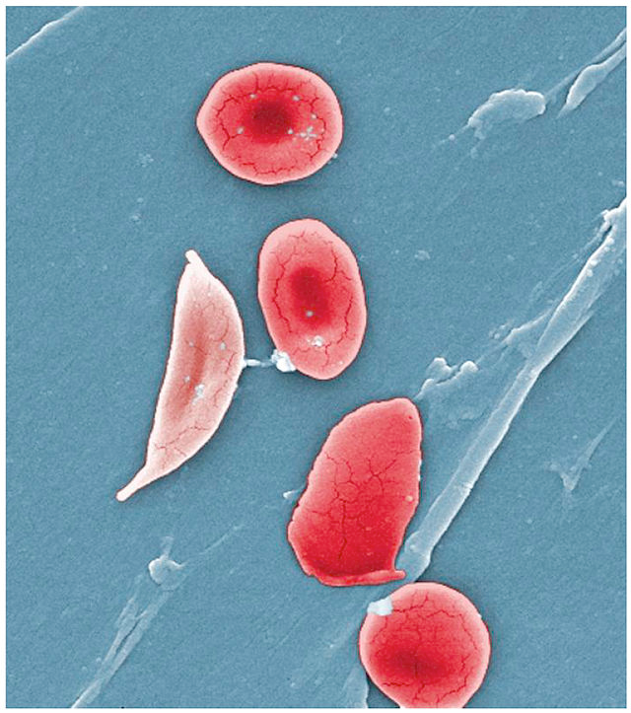
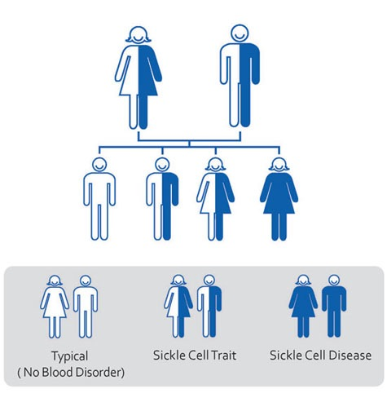
Two heterozygous parents
What are the chances of having a child with full sickle cell anemia (ss)?
Ss
Ss
S
s
S
s
What are the chances the second child will have full sickle cell anemia (ss)?
SS
Ss
ss
"1911 Sickle Cells" by OpenStax College - Anatomy & Physiology, Connexions Web site. http://cnx.org/content/col11496/1.6/, Jun 19, 2013.. Licensed under CC BY 3.0 via Wikimedia Commons

Slide 16
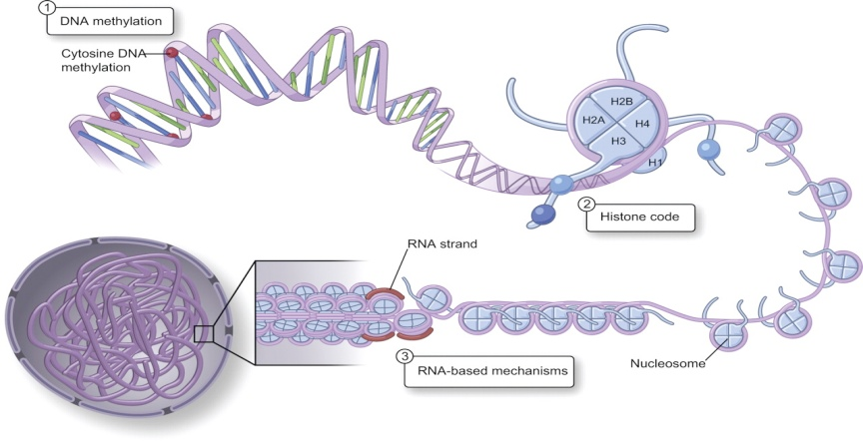
Epigenetics
Study of long-term, stable changes in DNA transcription
Hereditable change in phenotype
  No change in DNA sequence, but a change in DNA expression
Grandpa & You

Slide 17
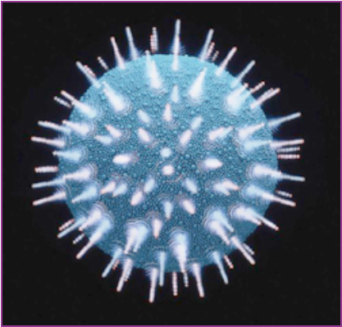
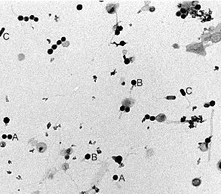
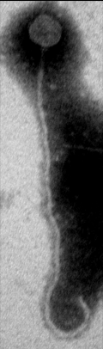
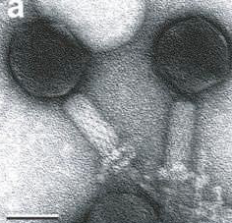
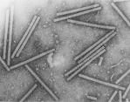
Viruses
Abundant
Diverse
Genome + Protein Shell
Tiny Killing Machines
HIV
Tobacco Mosaic Virus
Courtesy of K. Williamson & R.R. Helton

Slide 18

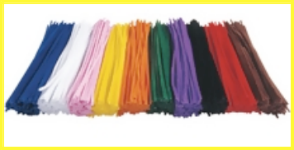
Build a Virus
Pick out 4 pipe-cleaners &12 straws
    Select 1 or 2 colors, but not more
    Combine at your discretion:
      4 red pipe-cleaners with 6 red & 6 blue straws
      2 red & 2 blue pipe-cleaners with 12 red straws

Slide 19
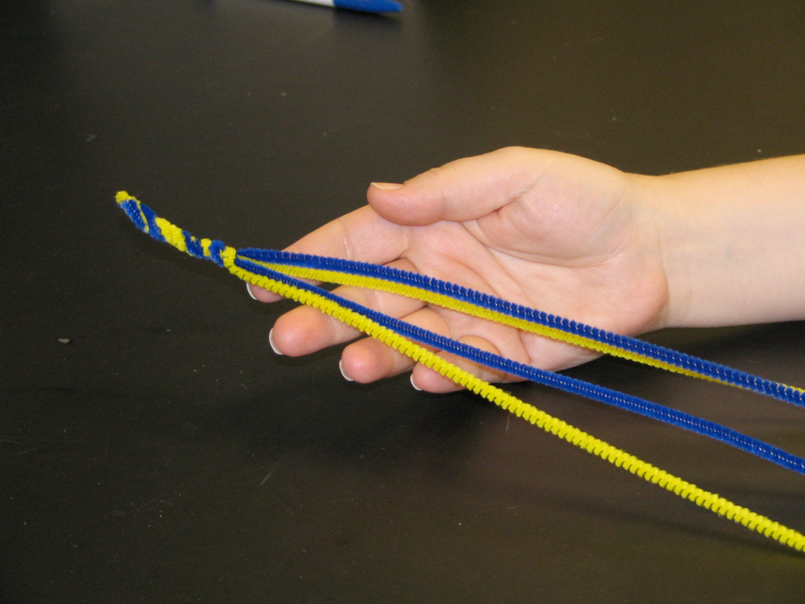
Hold the 4 pipe-cleaners together in a bundle in your hand.
Bend 1 end of the bundle of pipe-cleaners down the length of your thumb.
Twist together the short part of the pipe-cleaners that you just bent over.
  This is your virus’s nucleic acid viral genome.

Slide 20
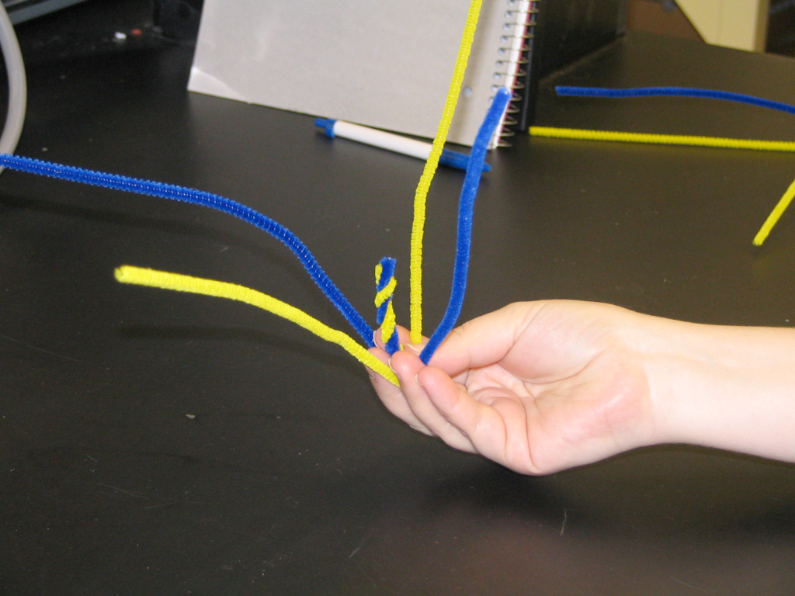
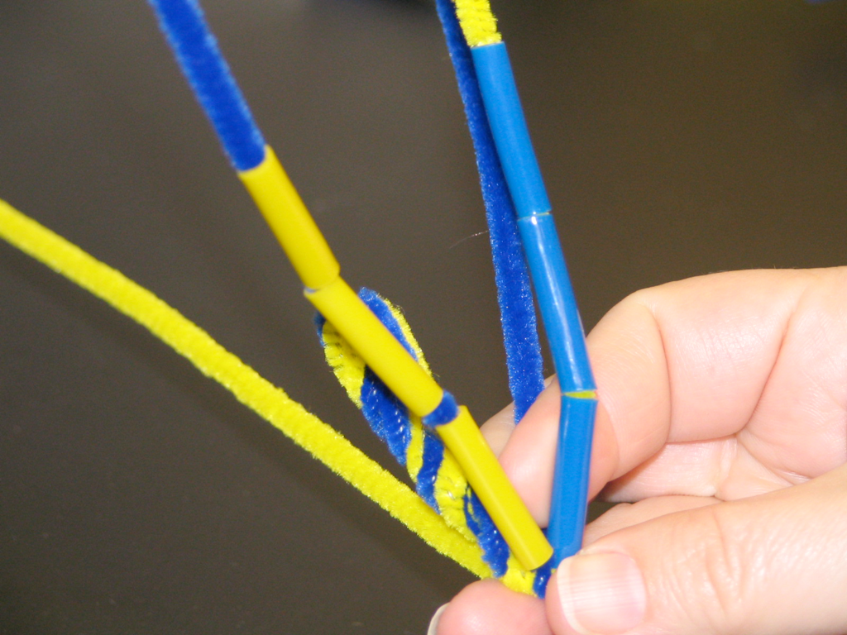
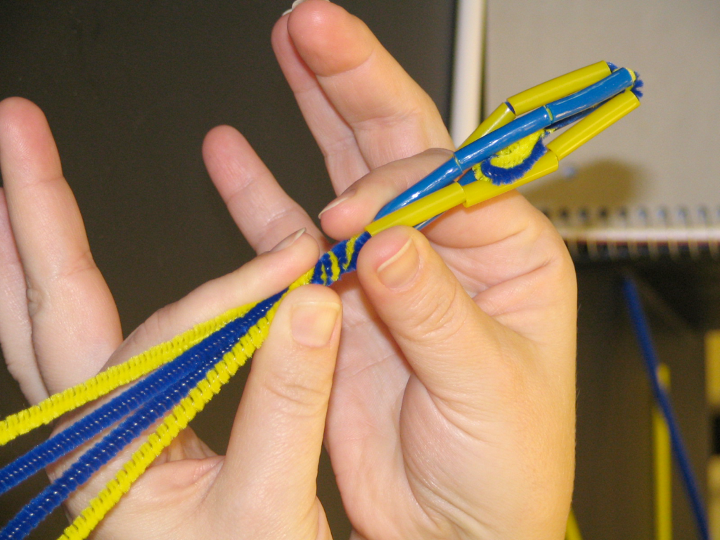
Hold the pipe-cleaners with the long ends pointing straight up.
Thread 3 pieces of straw on each pipe-cleaner.
Twist together the ends of the pipe-cleaners to create your virus’s tail.

Slide 21
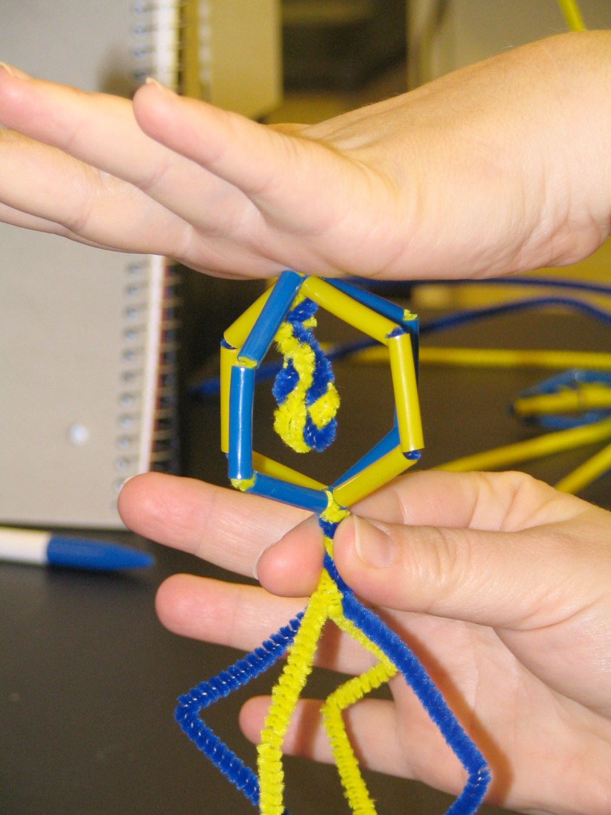
Press gently down on the top of the virus to expand the viral head.

Slide 22
Virus Genetics
Find a partner
Collect a worksheet
Look at each of your viruses’ genotypes
  Decide if they are homozygous or heterozygous based on genotype - the pipe-cleaner colors

Slide 23
Virus Genetics
Look at each of your viruses’ phenotypes
  Decide if your viruses correctly expressed their genotype on their capsid phenotype - straw colors vs. pipe-cleaner colors
Look at each of your viruses’ alleles
  Which are the dominant colors & which are recessive?

Slide 24
Virus Genetics
Your viruses have been eyeing each other longingly for a while now…
  What will your viruses’ offspring look like?
  Predict with Punnett square your offspring genotype & phenotype in the first generation
  Do your viruses show codominant or polygenic traits?

Slide 25
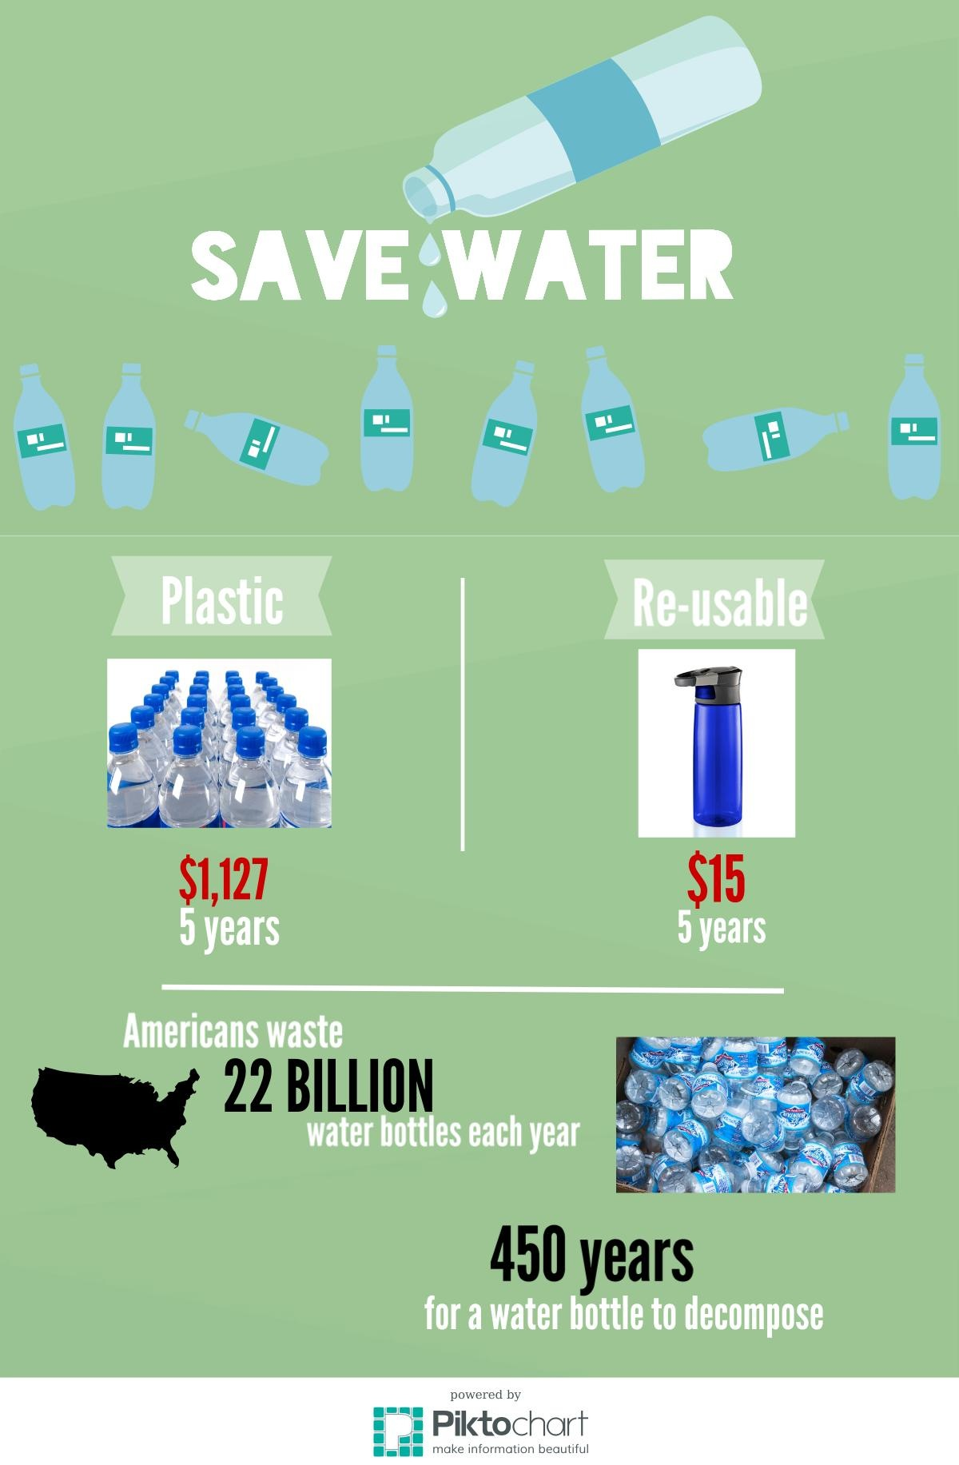
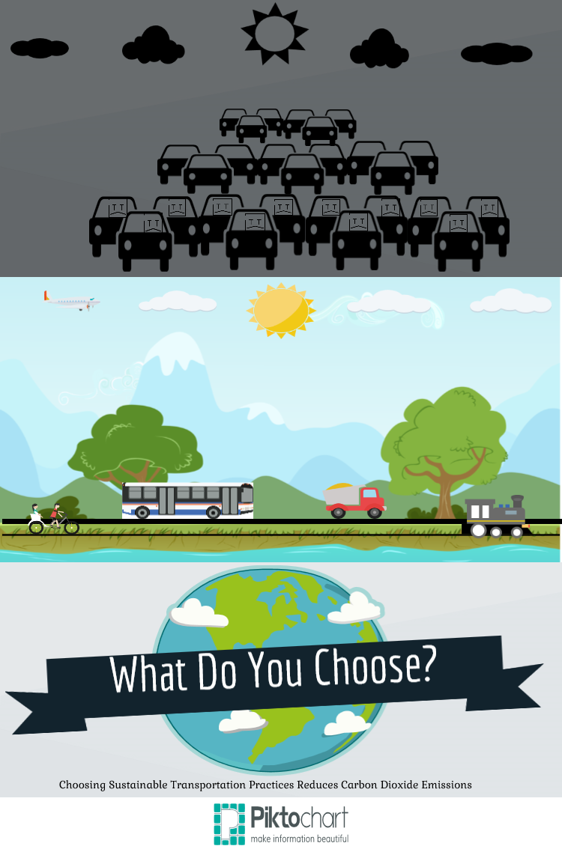


HOmework
Readings: Genetic Engineering & GMO Rice
Genetics Worksheet due Wed., Feb. 18
Infographic due Today
Distribution instructions on Blackboard

