Slide 1
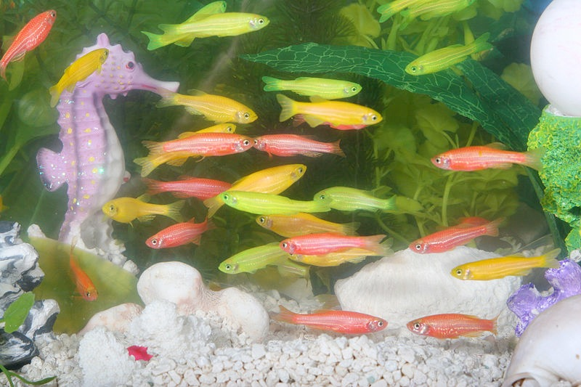
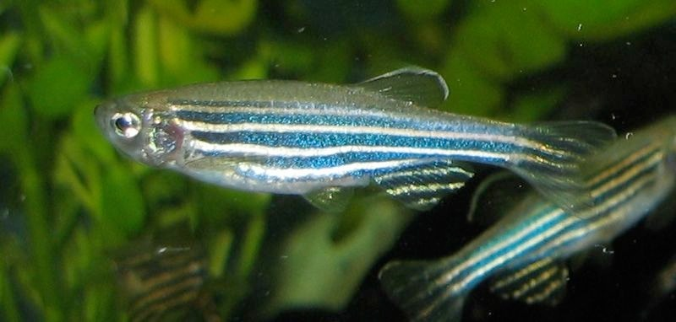
GeneticAlly Modified Organisms
Image used with copyright permission from www.glofish.com
BIO 1103 Winter 2015 February 13, 2015

Slide 2
Learning Objectives
Differentiate between artificial selection & genetic modification & cloning
Appreciate benefits of genetically modified organisms (GMOs)
Clarify concerns about GMOs
Prioritize biodiversity

Slide 3
Central Dogma of biology

Slide 4
Ballot Initiative No. 522
Label foods produced using genetic engineering
Would not include animals fed GMO feedstocks, alcohol or food processed with genetically engineered (GE) enzymes

Slide 5
Ballot Initiative No. 522
Opposition - Misleading & un-necessary labeling
Increase costs for re-labeling - >$450 / family / year
Hurt farmers & suppliers - potential lawsuits, new regulations to meet

Slide 6
Ballot Initiative No. 522
Support - Straightforward, transparent food labeling
Boost for international sales
No ban on GMOs or GE foods, no pet food labeling
Not raise food prices
Not hurt farmers - 18 months for compliance & fine exemptions

Slide 7
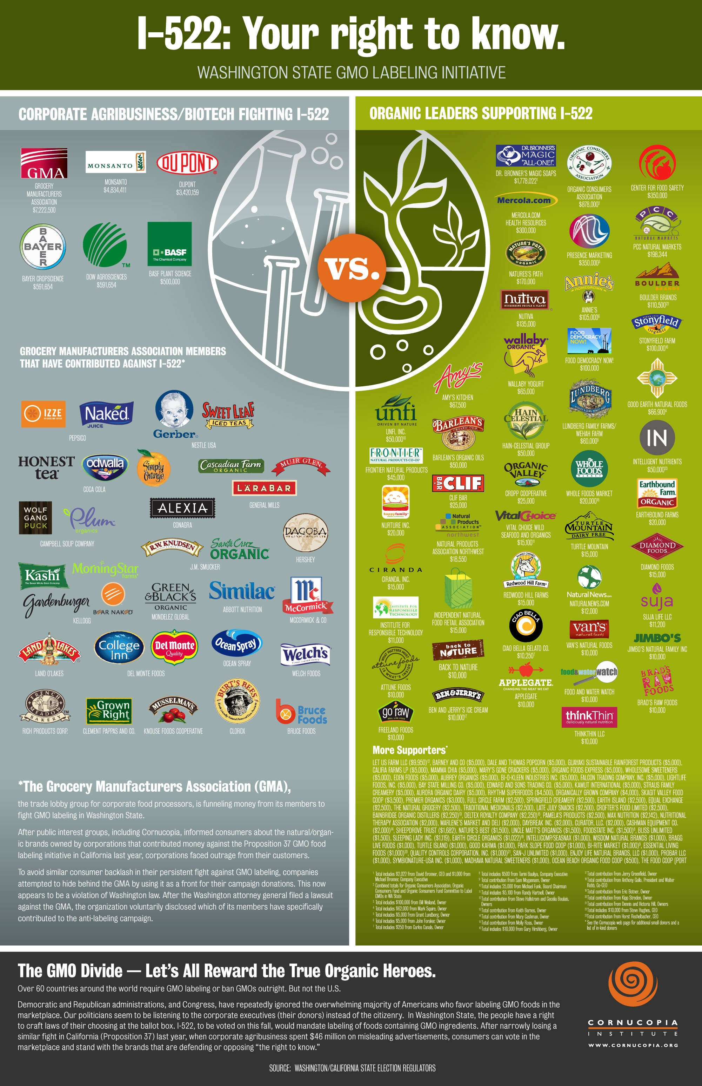

Slide 8
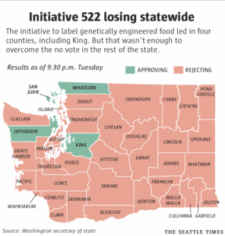
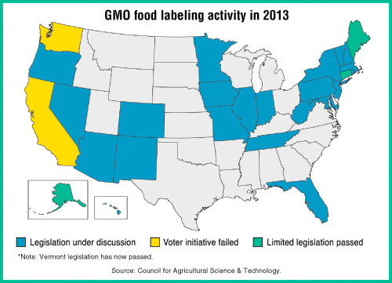
51% No
49% Yes
Washington - No labeling
California - No labeling
Colorado - No labeling
Oregon - No labeling
Vermont - Yes, but challenged

Slide 9
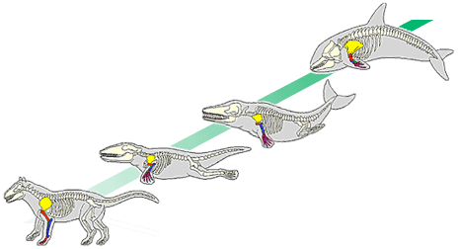
Natural Selection
Different alleles = genotypes = phenotypes
Different phenotypes = different survival rates
More successful phenotypes produce more offspring = natural selection
Shifts in genetics at population or species level over time = evolution
Transitional forms in whale evolution
http://evolution.berkeley.edu/evolibrary/article/evo_51

Slide 10
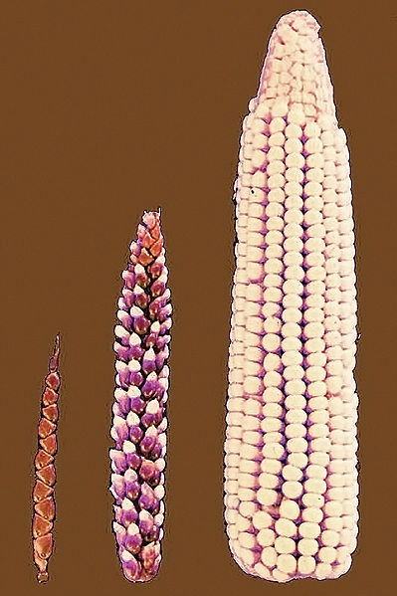
Genetic Modification
Ancient technique
Artificial selection - organisms which exhibit specific, desired traits are selected to breed subsequent generations
Basis of agriculture & animal husbandry - selective breeding
Limited to natural variation in traits
Genetically Modified Corn— Environmental Benefits and Risks Gewin V PLoS Biology Vol. 1, No. 1, e8 doi:10.1371/journal.pbio.0000008 Photo by
John Doebley

Slide 11
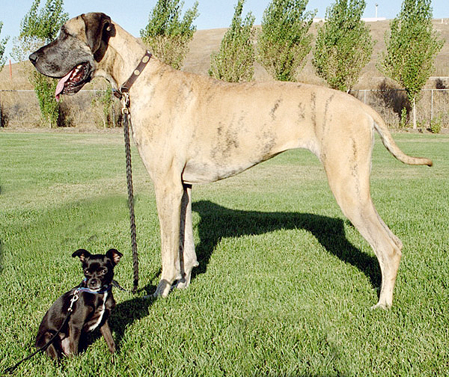
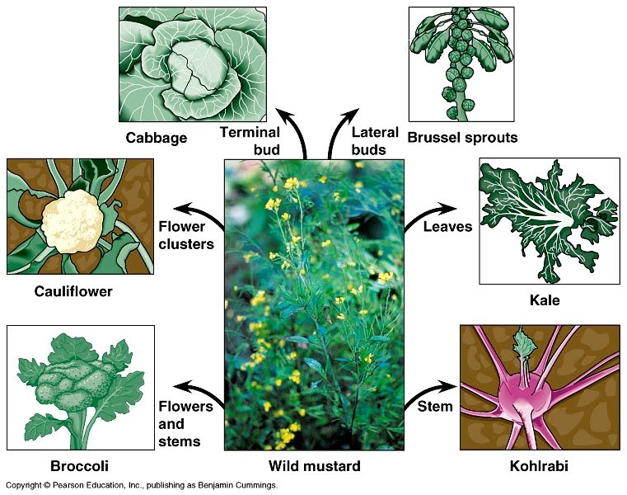
Artificial Selection
Ellen Levy Finch

Slide 12
Genetically modified organisms
New technique
Genetically modified organisms (GMOs) - incorporate new traits into a species from an unrelated organism
any living organism that possesses a novel combination of genetic material obtained through the use of modern biotechnology aka genetic engineering
Advances modern agriculture & animal husbandry
Not limited to natural variation of a species

Slide 13
Genetic engineering
Direct manipulation of an organism’s genome by biotechnology
Genes inserted with cloning, insertion, DNA synthesizing (horizontal gene transfer)
Genes removed with “knock-outs”
Genes mutated by point mutation, adding exon or intron & nucleotide deletion

Slide 14
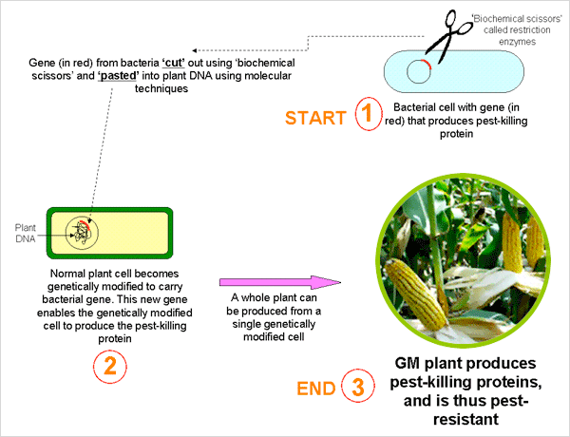
Genetic Modification Advisory Committee, 2007

Slide 15
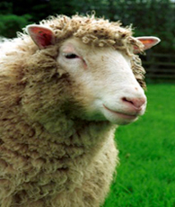
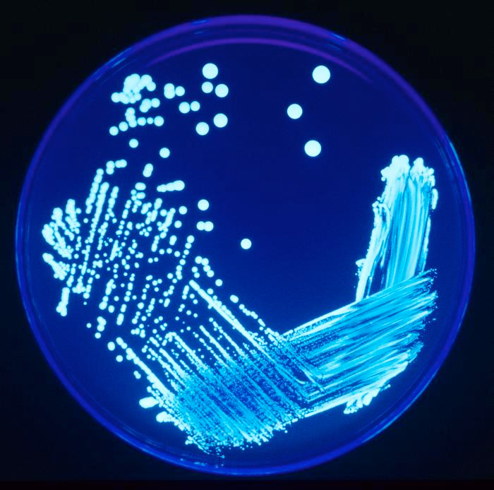
Cloning
Clones = genetically identical individuals
Natural process - unicellular organisms, lizards, plants
Human-induced process - copy pieces or all of an organism’s DNA using biotechnology
Bacteria, yeasts, plants, animals
Dolly the cloned sheep
© The Roslin institute
Image courtesy Wikimedia Commons

Slide 16
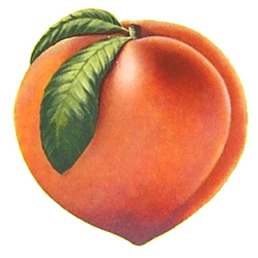
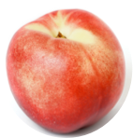
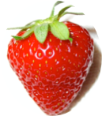
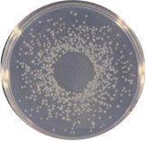
Artificial Selection
Genetic Modification
Cloning
Peach
Nectarine
Strawberry
P. syringae
Peach
Peacherine
Frost-resistant Strawberry
Peach
Strawberry by Rlaferla at English Wikipedia

Slide 17
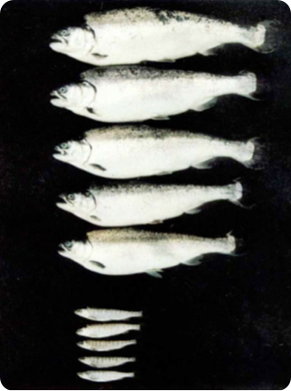
Bacteria
Yeast
Insects
Plants
Fish
Mammals
Genetically modified salmon (top), engineered for seawater adaptability, are larger and have silver bodies. Non-genetically modified siblings of the same age (bottom) are smaller and have grey and silver striped bodies. The length (fork length) of the topmost large fish is 41.8 cm.
© 1994 Nature Publishing Group Devlin, R. H. et al. Extraordinary salmon growth. Nature 371, 209 (1994).

Slide 18
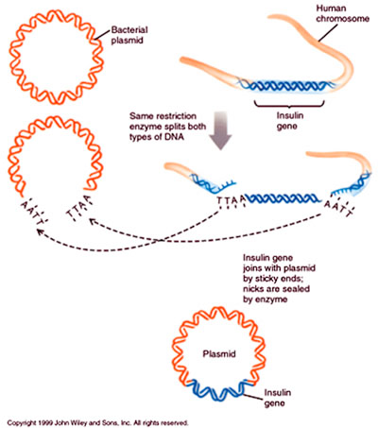
GMO History
1973 - Bacteria
1974 - Mice
1976 - Genetic engineering company formed, Genentech
1980 - Supreme Court allowed patenting GMOs
1982 - Insulin producing bacteria commercialized
1994 - Flavr Savr tomatoes
2003 - GloFish
2010 - Venter Institute synthesizes entire genome & places in an empty cell
2012 - States take up GMO labeling initiatives

Slide 19
List what you see as the “benefits” & “concerns” about GMOs

Slide 20
Benefits of GMOs
Optimize agricultural performance
Increase yield
Reduce cost & pesticides
Drought & frost tolerance
Enhance food quality
Resist pests and disease
Heavy metal & salt tolerance
Create pharmaceuticals
Reduce cost
Increase production capacity
Benefits growing population

Slide 21
HOmework
No class Monday, Feb. 16
Readings & Video: Apple, GMO Myths & Captain America
Genetics Worksheet due Wed., Feb. 18
Infographic distribution instructions on Blackboard

Slide 22
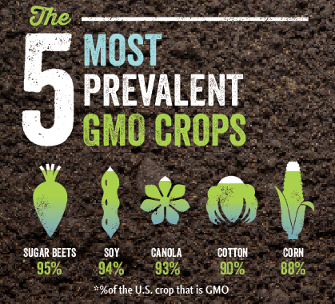
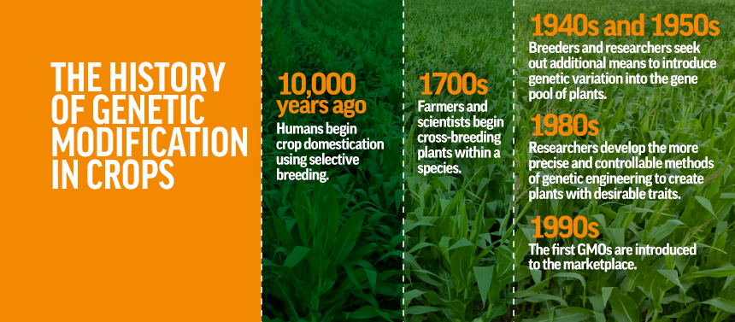
http://www.scientificamerican.com/article/a-hard-look-at-3-myths-about-genetically-modified-crops/

