Slide 1
GMO Consequences
BIO 1103 Winter 2015 February 18, 2015

Slide 2
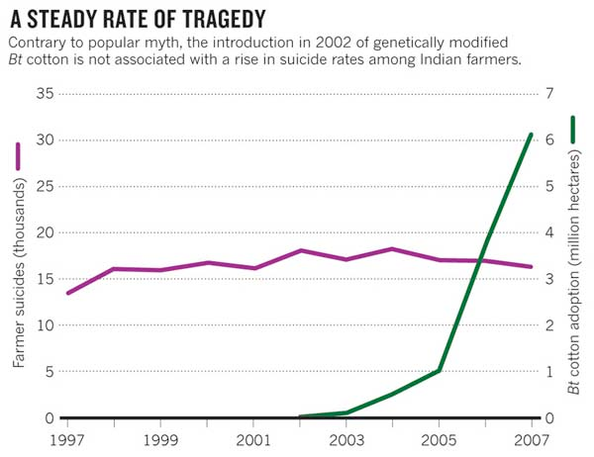
Learning Objectives
Appreciate benefits of genetically modified organisms (GMOs)
Clarify concerns about GMOs
Evaluate case studies of GMOs
Prioritize biodiversity
Image: Courtesy of Nature

Slide 3
Genetic Engineering
Cloning
Artificial Selection

Slide 4
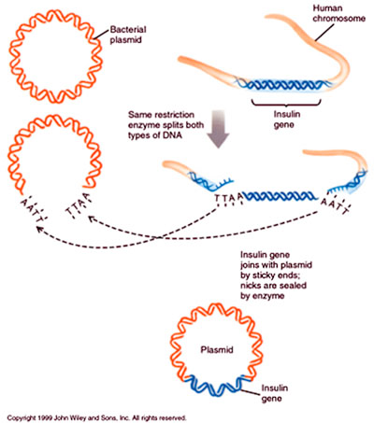
GMO History
1973 - Bacteria
1974 - Mice
1976 - Genetic engineering company formed, Genentech
1980 - Supreme Court allowed patenting GMOs
1982 - Insulin producing bacteria commercialized
1994 - Flavr Savr tomatoes
2003 - GloFish
2010 - Venter Institute synthesizes entire genome & places in an empty cell
2012 - States take up GMO labeling initiatives

Slide 5
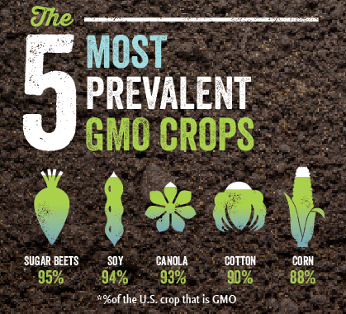
Why utilize GMOs?

Slide 6
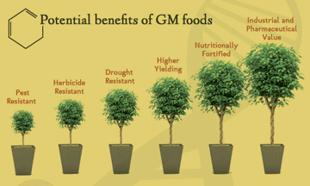
Optimize agricultural performance
Increase yield
Reduce cost & pesticides
Drought & frost tolerance
Enhance food quality
Resist pests and disease
Heavy metal & salt tolerance
Create pharmaceuticals
Reduce cost
Increase production capacity
Benefits growing population

Slide 7
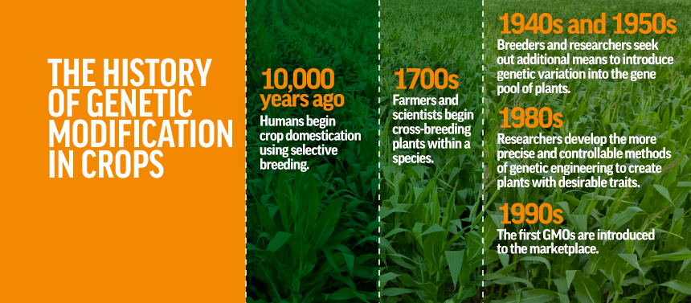
Agriculture

Slide 8
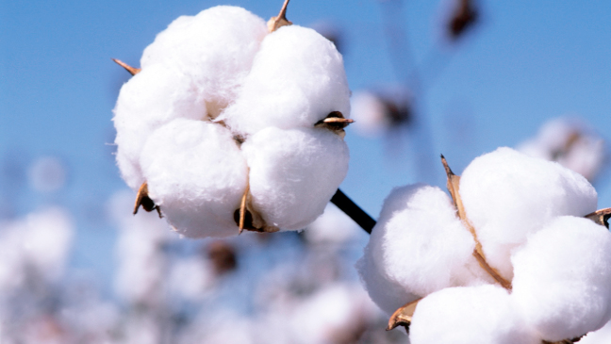
Agriculture
Herbicide resistant soybeans, maize, rapeseed & cotton - RoundupReady & LibertyLink
Insect resistant corn
Virus resistant plums, papaya & tobacco
Golden rice - makes pre-cursor to Vitamin A
Biofuel production - algae, jathropa, maize & poplars

Slide 9
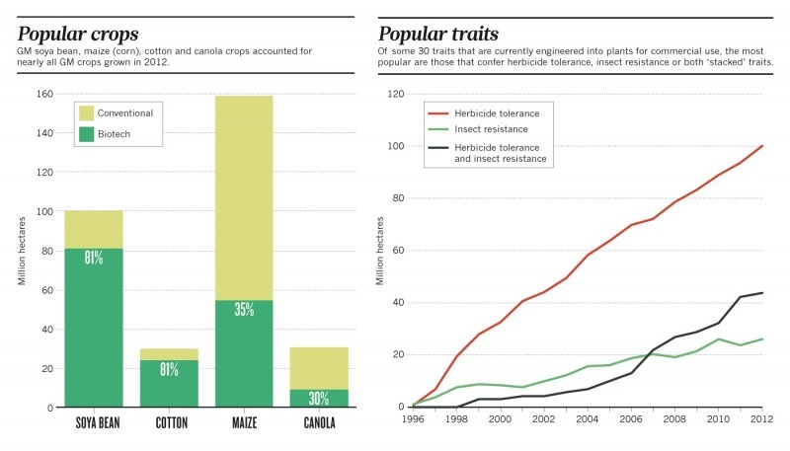
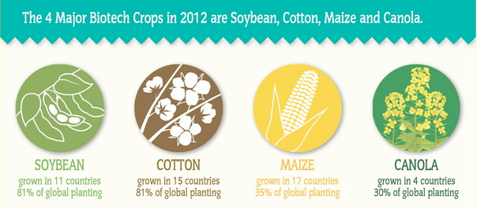
Global GMO agriculture
The Washington Post, 2013

Slide 10
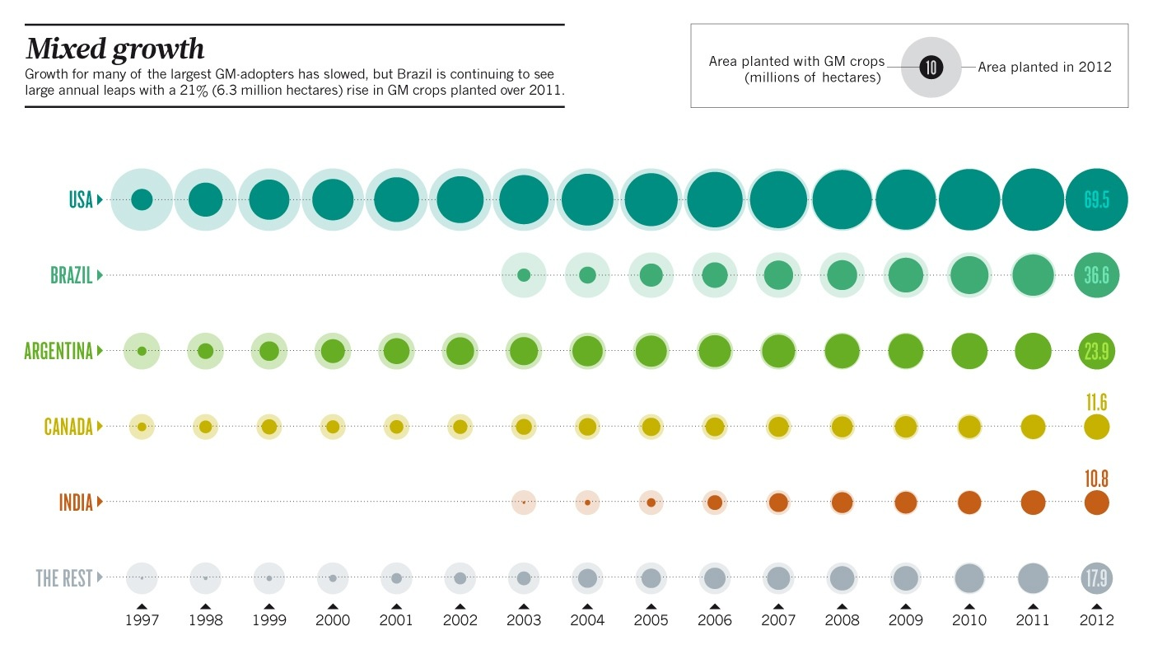
The Washington Post, 2013

Slide 11
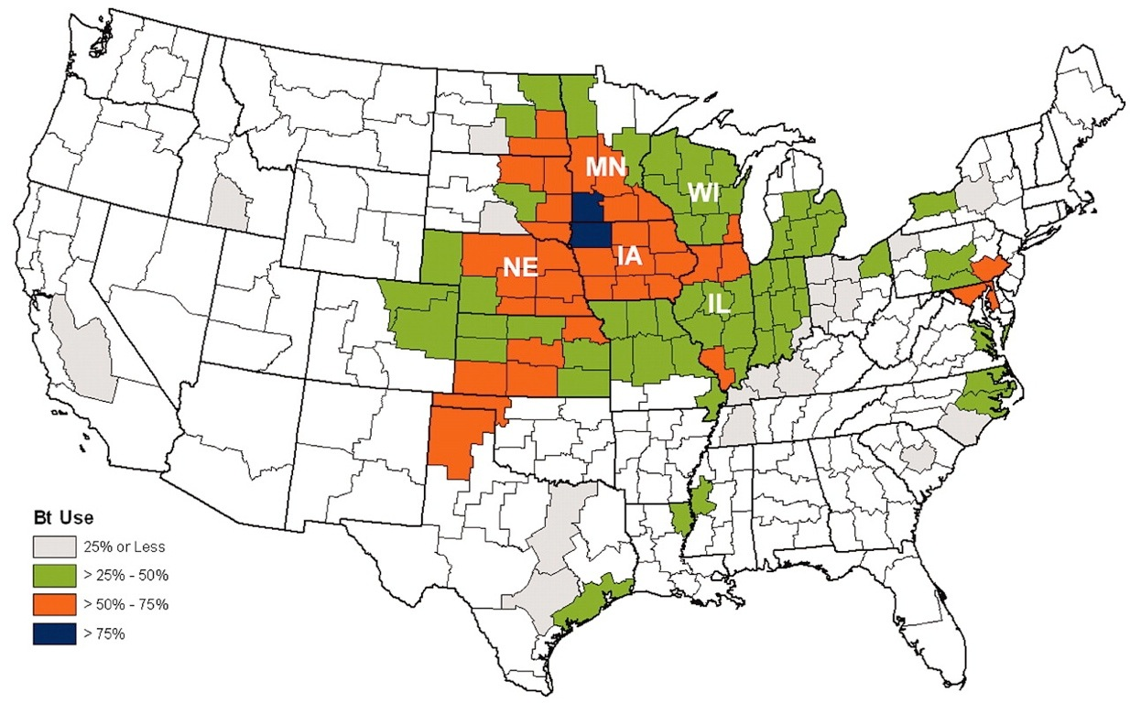
Bt Maize
Corn that expresses insecticide proteins from Bacillus thuringiensis - resistant to corn borer, corn ear worms, root worms
Spatial distribution of maize containing one or more Bt traits for O. nubilalis control in 2006 in the United States. Bt maize data are from USDA crop reporting districts reporting >40,470 ha of maize, including the five states represented in this analysis (IL, Illinois; MN, Minnesota; WI, Wisconsin; IA, Iowa; NE, Nebraska). Areas in white had negligible maize hectares. Data are based on addresses of customer or retail outlet seed sales accounts, which may not accurately indicate cropping districts in which seed was ultimately planted. [©2008 Agricultural Biotechnology Stewardship Technical Committee]

Slide 12
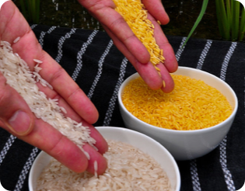
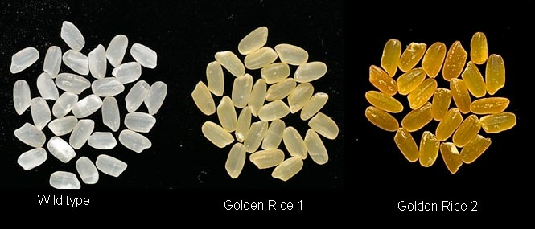
Golden Rice
> 190 million children worldwide suffer Vitamin A deficiency
Initial GMO concern: not enough Vit A
Resolution: new strains
Pandora’s box to wide-spread GMO use?
Who benefits?
International Rice Research Institute (IRRI)

Slide 13
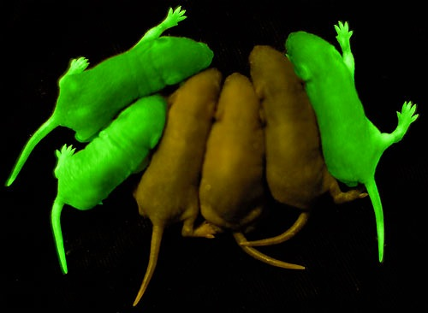
Medicine
Insulin via bacteria - 1982
Human growth hormone via plants - 1986
First antibody via plants - 1989
Transgenic mice carry human genes for studies of expression, mutation, and medical trials
Green fluorescent protein from jellyfish to study gene expression in bacteria, yeast, pigs, mice, fruit flies
National Institute of Health

Slide 14
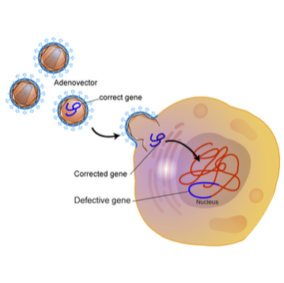
Future Possibilities
Vaccine production
Fuel production
Biodegradation
Spider silk
Tissues and organs for transplant - xenotransplantation
Gene therapy - viruses deliver genes to cure disease
Images and animations are courtesy of the National Human Genome Research Institute's Talking Glossary (http://www.genome.gov/glossary/).

Slide 15
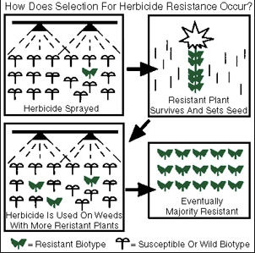
Environmental
Changes in organisms with foreign gene expression
Competition between wild-type & GMOs
Changes in biodiversity
Herbicide resistance in weeds - natural selection
Antibiotic resistance in bacteria - horizontal gene transfer
Courtesy of University of Minnesota Extension Office

Slide 16
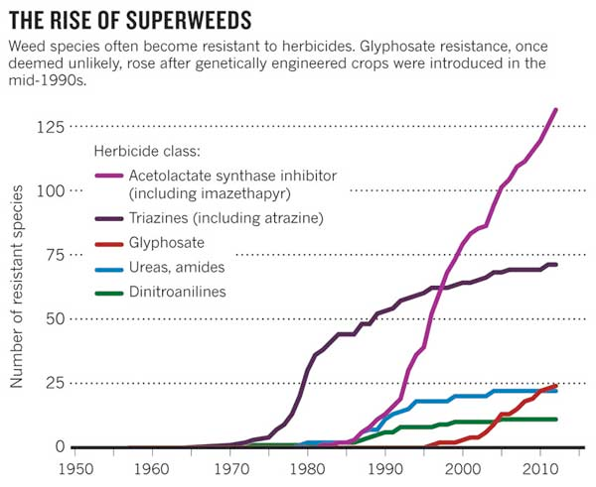
Image: Courtesy of Nature

Slide 17
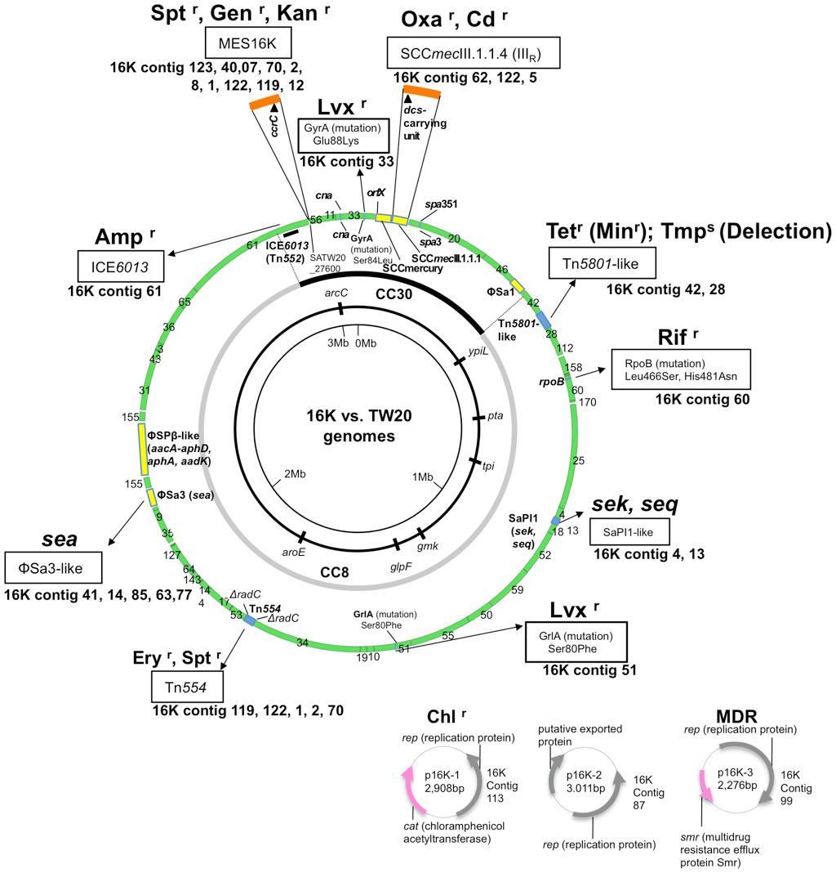
Methicillin-Resistant Staphylococcus aureus (MRSA)
Resistant to 10 major antibiotics
Natural selection & genetic engineering
Yamamoto et al. 2012. PLOS One

Slide 18
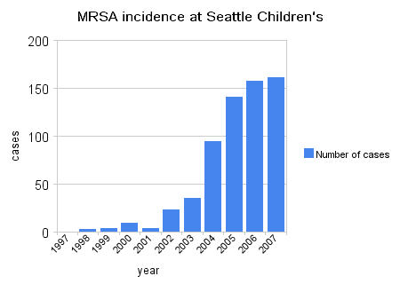
Increase in HA (hospital acquired)-MRSA infections among patients in Seattle Children's Hospital through 2007. HA-MRSA is more dangerous than CA(community acquired)-MRSA. Courtesy of MicrobeWiki.

Slide 19
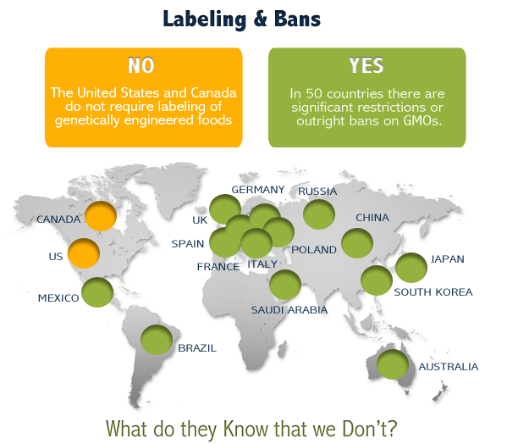
Economic
Affordable medicines
Reduced pesticide/herbicide use
Patented GMOs favor GMO producers - no evidence
New challenges
Intellectual property rights
Privacy & use of genetic information
Patenting of life forms
Courtesy of www.labelgmos.org

Slide 20
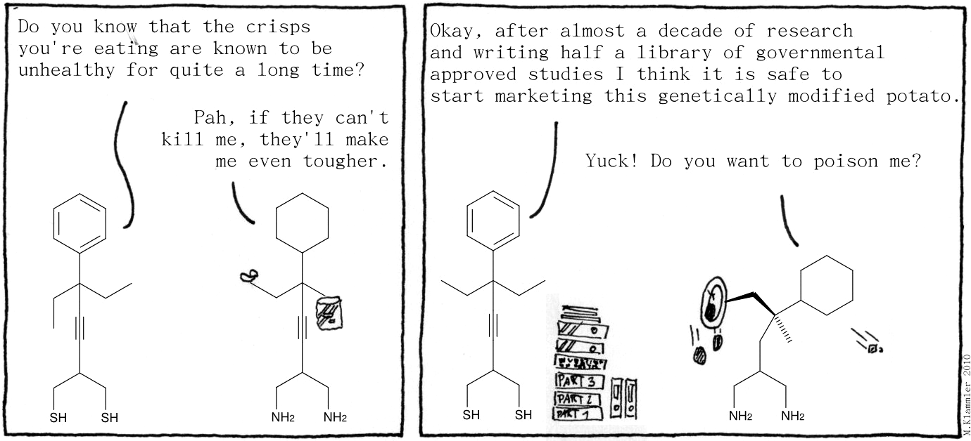
Social
Fight disease & promote human health - personalized medicine
Horizontal gene transfer - no risk in humans

Slide 21
Social
Ethical conundrums
Food choices - organic farming
Food labeling
Plant, animal & ecosystem rights
Role of science & technology in society
Uncertainty

Slide 22
Man or GMO?
Should we or shouldn’t we?
How do we know when we have gone too far?

Slide 23
HOmework
Genetics Worksheet due Today
Habitat Worksheet due Mon. Feb. 23
Bring picture of an endangered species Friday & know why it is endangered

