Slide 1


Making Visual Products
Maps that tell the story at a glance…

Slide 2
The color density indicates the microorganism population found at each location on the map.
At a glance, you can spot where the microorganisms are most abundant.
In this case, the presence of extremophile microorganisms points to the presence of Arsenic, a mine tailing pollutant.
The Map tells the story at a glance.

Slide 3
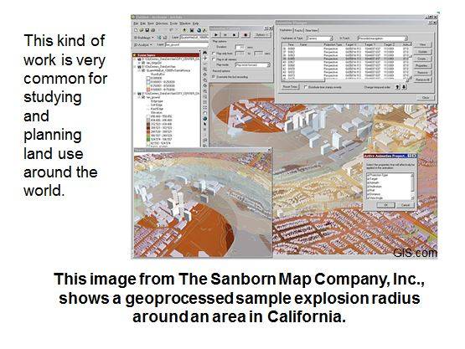

Slide 4
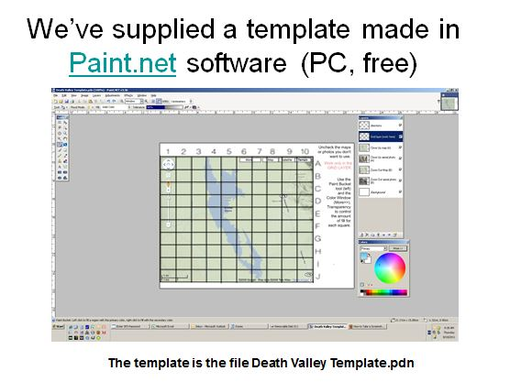

Slide 5
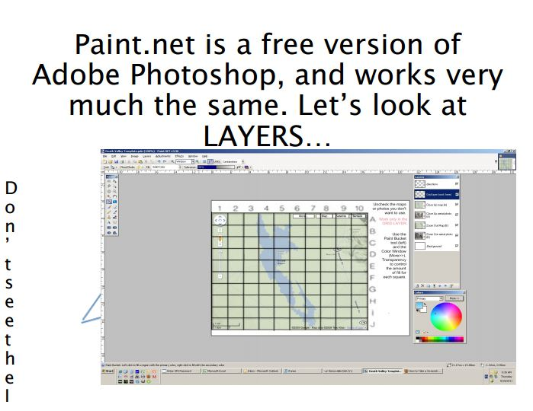

Slide 6
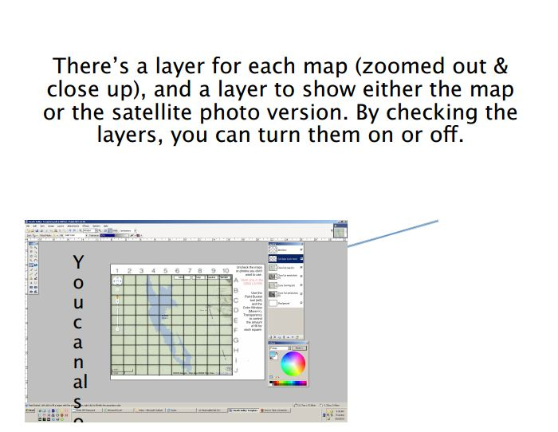

Slide 7
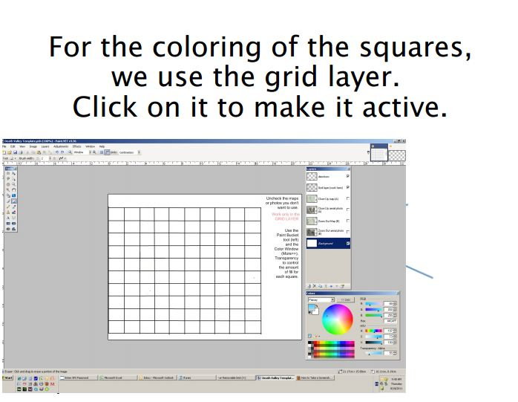

Slide 8
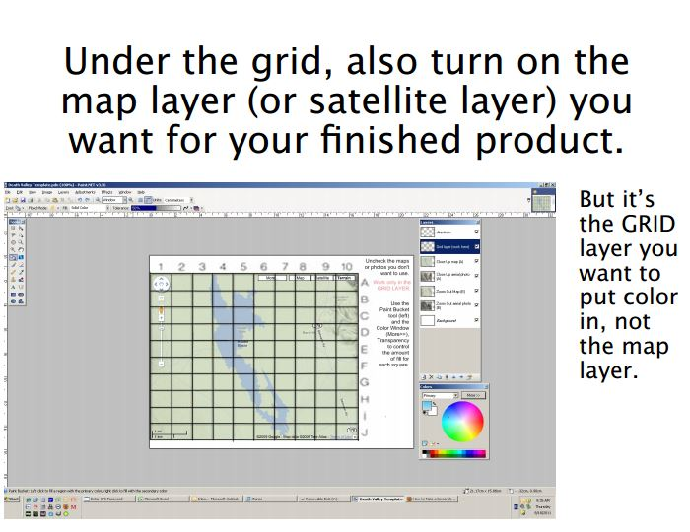

Slide 9
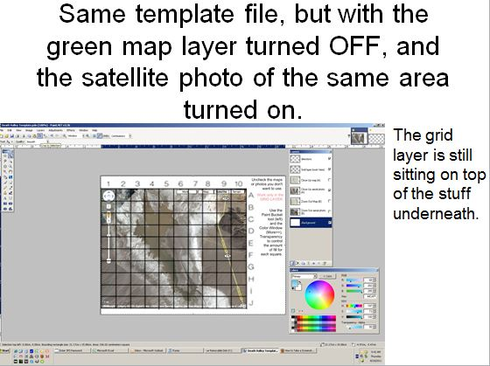

Slide 10
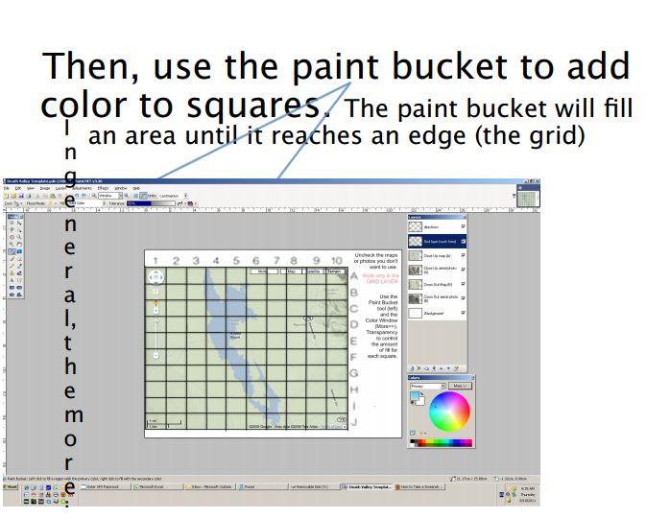

Slide 11
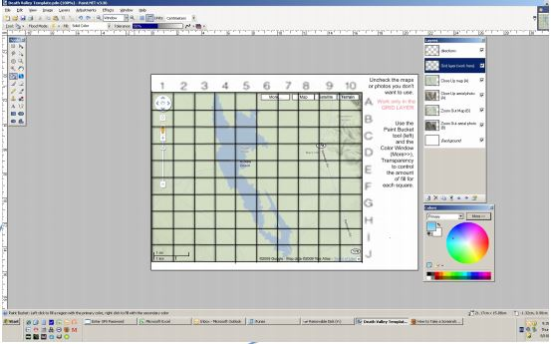


Slide 12
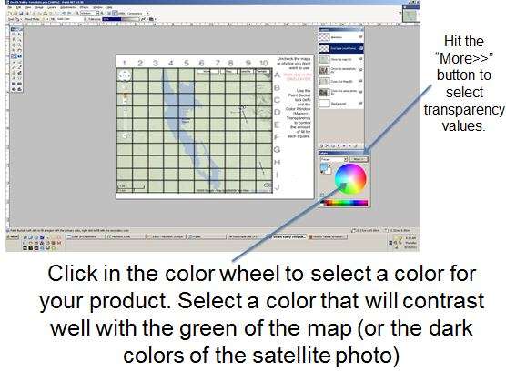

Slide 13
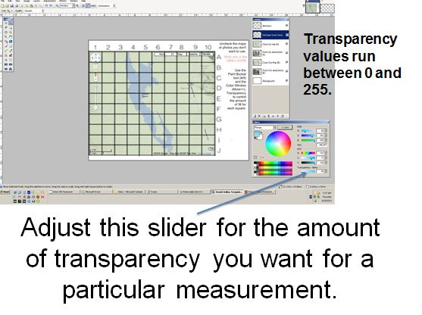

Slide 14
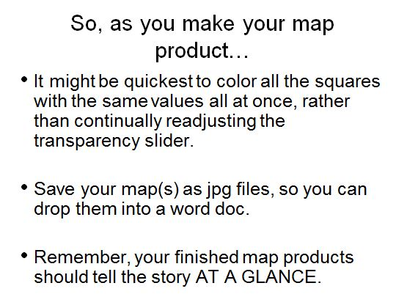

Slide 15
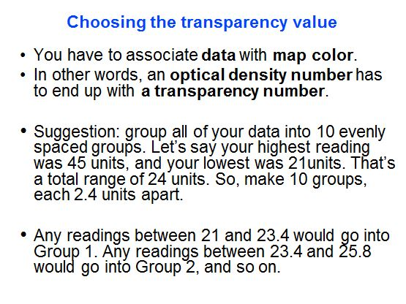

Slide 16
