Slide 1
NGSS? Got it covered! Bring engineering to your biology course. Engage students with a case study involving halophiles as indicators of ecosystem health. Challenge students to design, build, use a data collection device while they collaborate to address an environmental issue.
Claudia Ludwig, MEd, NBCT
Teacher and Education Program Director
206-732-1453
cludwig@systemsbiology.org
Mari Knutson Herbert, MS, NBCT
Teacher and Curriculum Developer
Lynden High School
KnutsonM@lynden.wednet.edu
@SystemsEd
https://www.facebook.com/systemseducation

Slide 2
Agenda
Overview of the program
Brief description of lessons
Time to explore

Slide 3
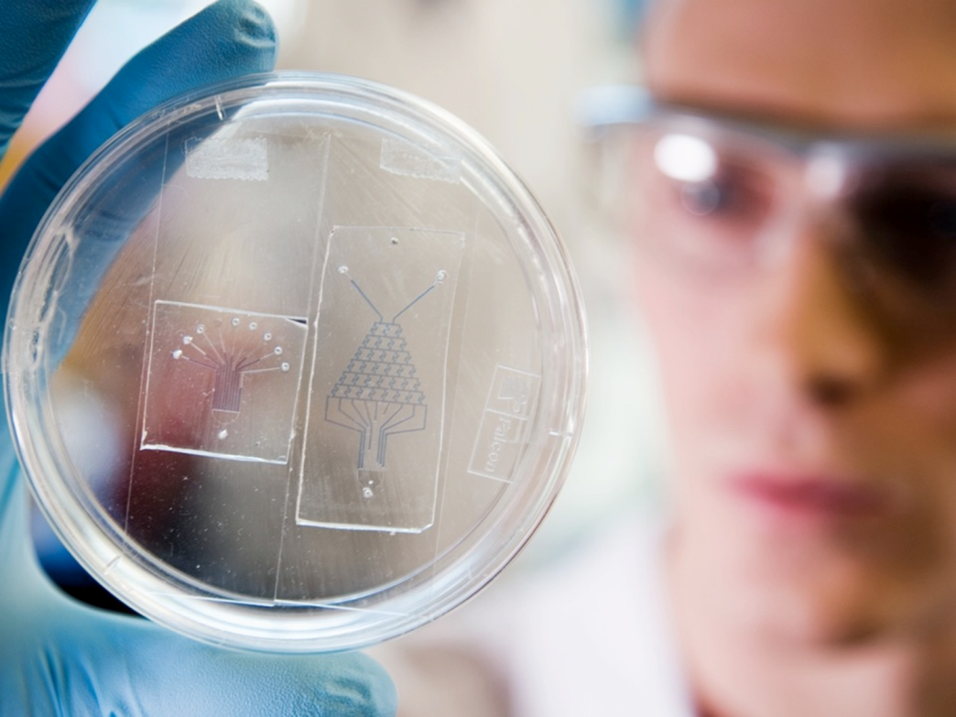
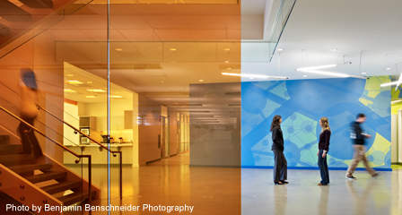
Institute for Systems Biology (ISB)
Vision: Wellness for humans and the planet.
Mission: Revolutionize science, transform human health, and ensure environmental sustainability.
Nonprofit research group using systems biology
Notes:
Systems Biology is STEM in practice. Learn about 4 interdisciplinary systems biology curriculum units that bring a variety of STEM topics, practices and habits to your students.

Slide 4
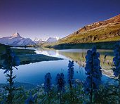
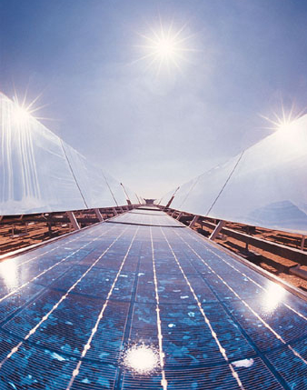
Health Care
Agriculture
Environment
Energy
Notes:
Swiss Alps: https://en.wikipedia.org/wiki/Natural_environment

Slide 5
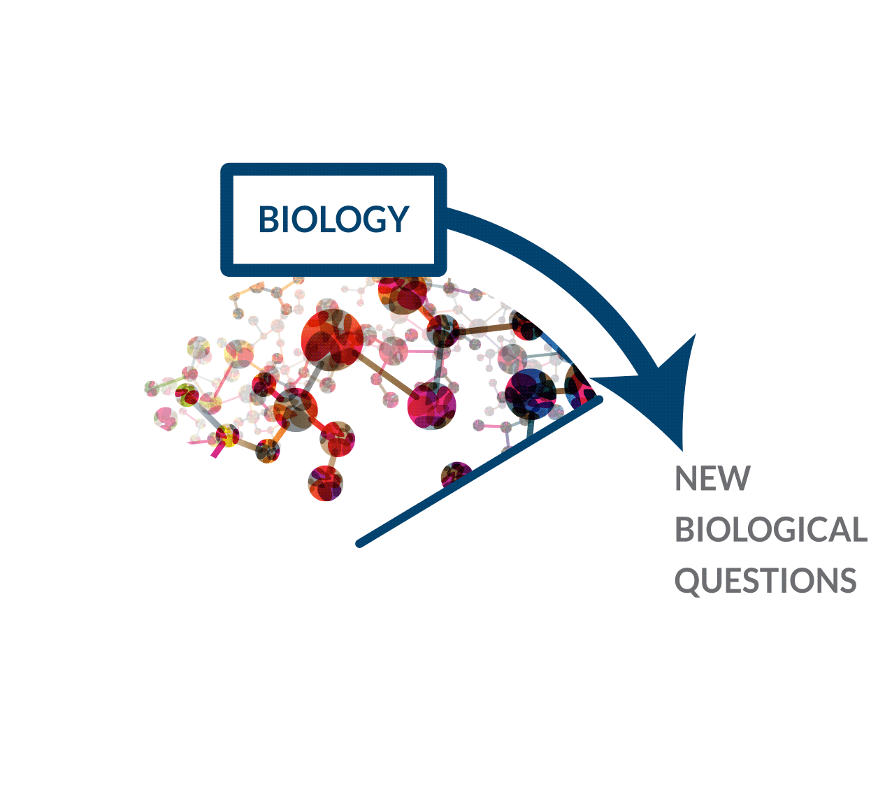
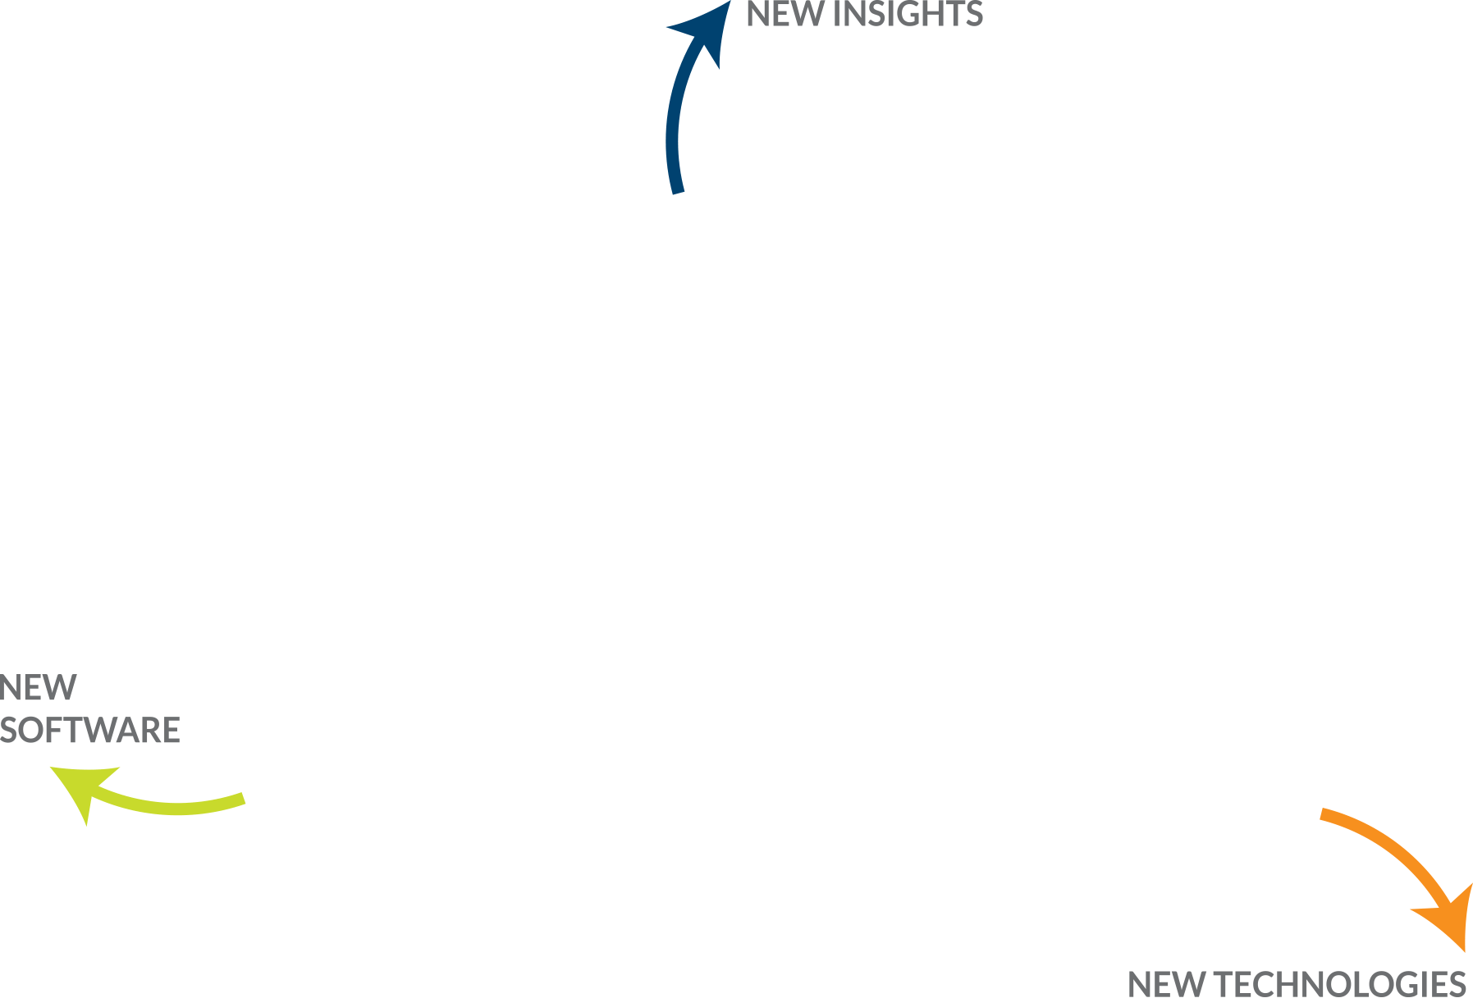
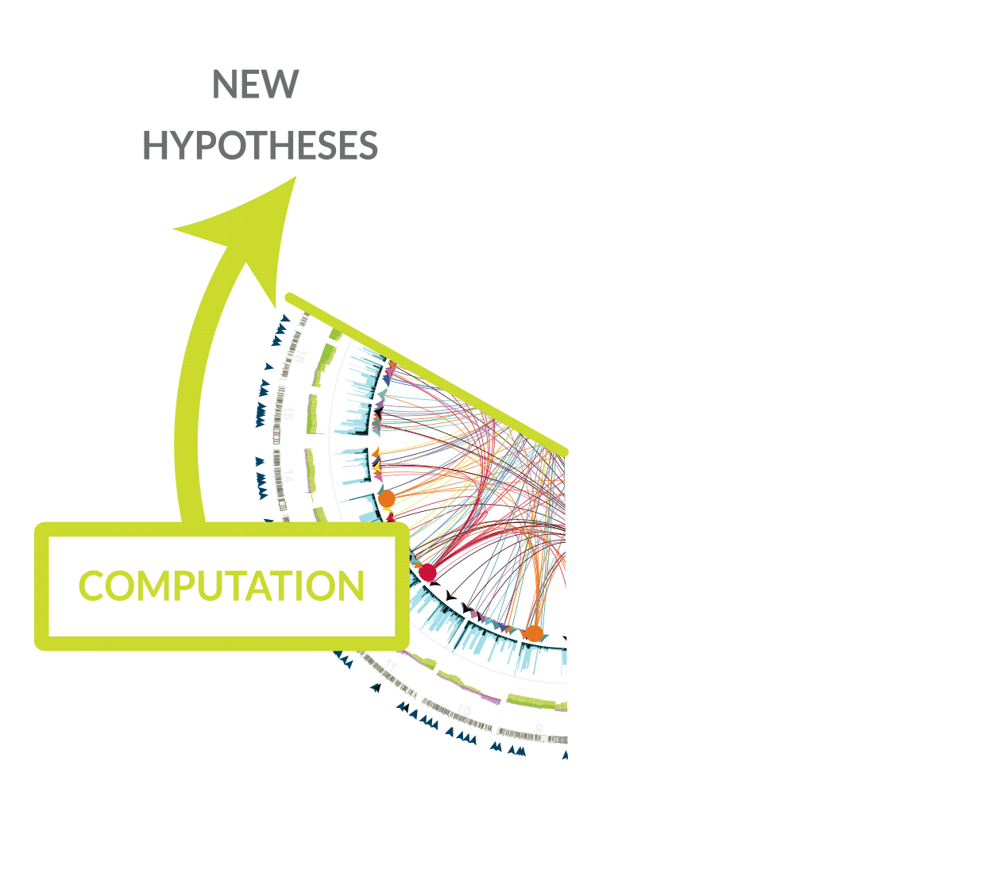
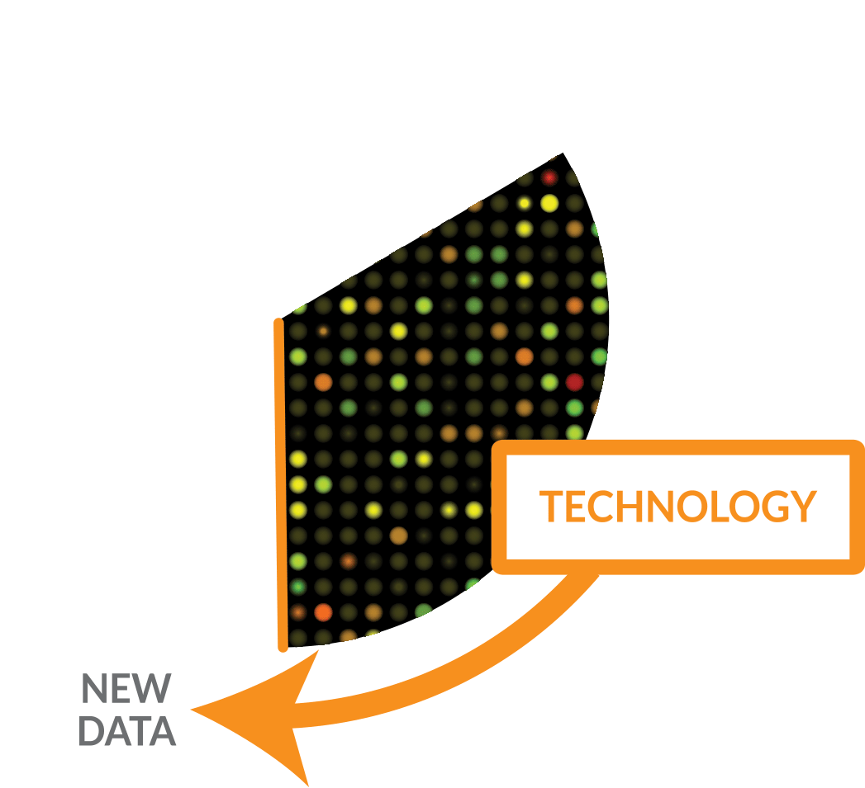
Cycle of Systems Biology

Slide 6
Biology is moving from descriptive science to quantitative science, which is necessarily integrative – training systems thinkers is imperative

Slide 7
Mission: Cultivate cross-disciplinary skills for solving complex problems
Notes:
Goal: Foster development of the thinking and concepts of systems biology by using a common problem that brings together biology, chemistry, physics, mathematics, statistics and computer science (STEM).

Slide 8
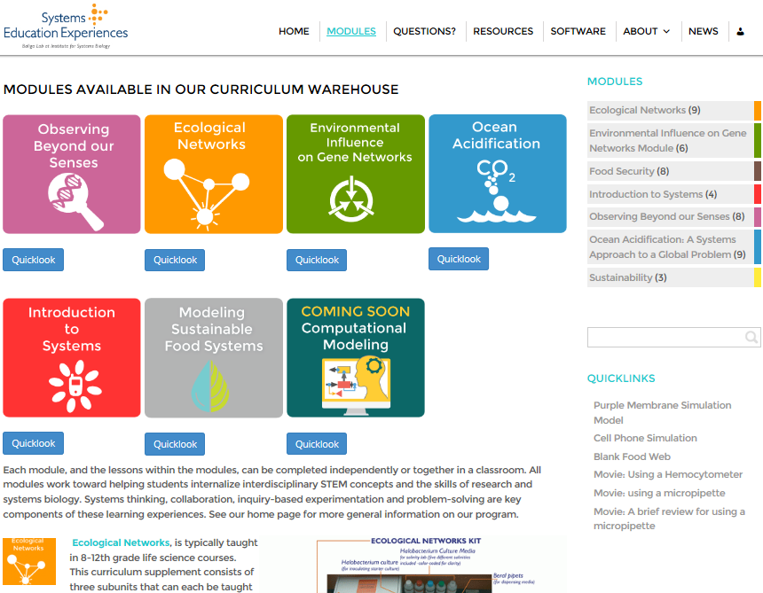
https://see.systemsbiology.net/modules/

Slide 9
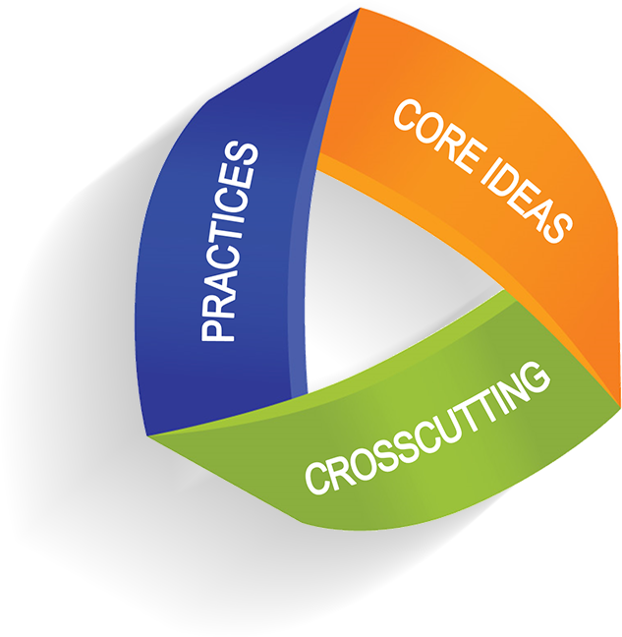
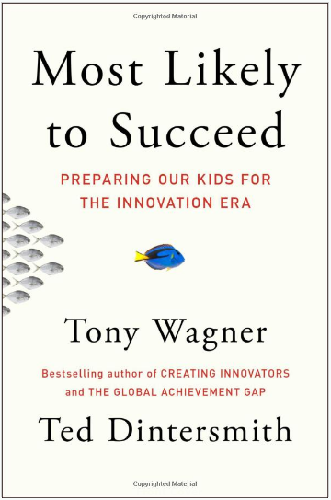
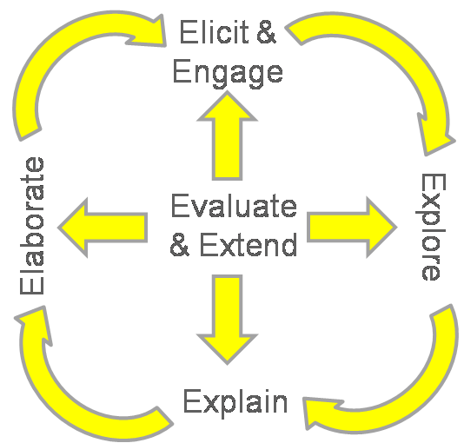
All modules are
Engaging
Inclusive
Collaborative
Interdisciplinary
Hands-on
Inquiry-based
Standards and research-based
Written to guide pedagogy
Focused on thinking and systems approaches
Based on a problem, phenomenon, or case study
Free and adaptable online with all needed materials
Widely used in schools
Notes:
… does not place groups in opposition to each other. It respects diversity but does not imply a lack of commonality it supports the concept of widening participation, but does not imply an externally imposed value judgment; it values equality of opportunity, but encourages all to feel that this relates to them, and that the issues are not just projected as being relevant to groups more commonly defined as disenfranchised, and translated into universities’ targets for equality. (Croucher and Romer, 2007: 3) students’ entitlement to access and participate in a course is anticipated, acknowledged and taken into account. Croucher and Romer’s definition states that an inclusive approach:

Slide 10
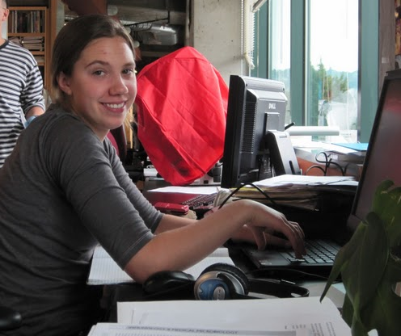
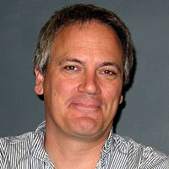
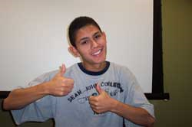
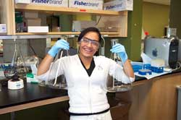
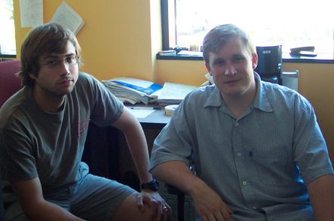
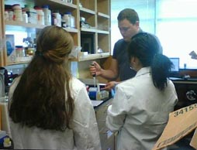
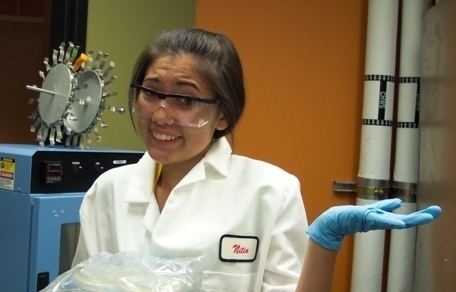
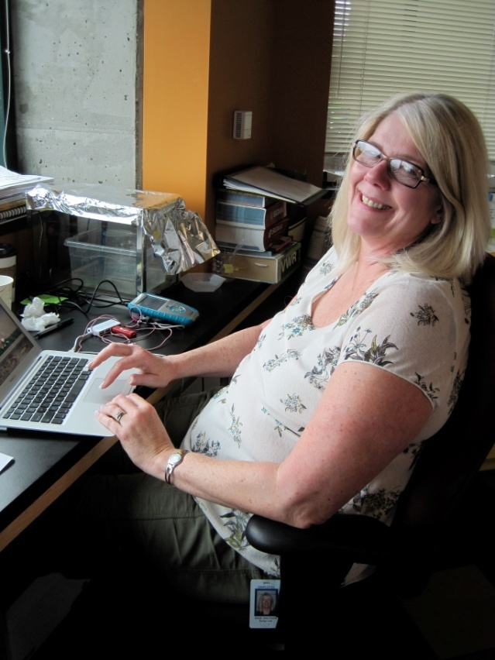
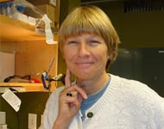
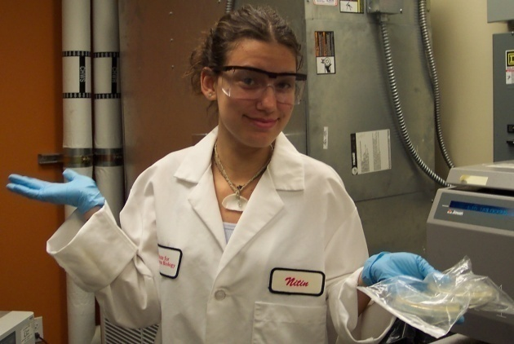
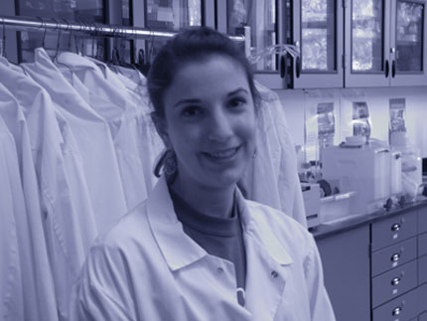
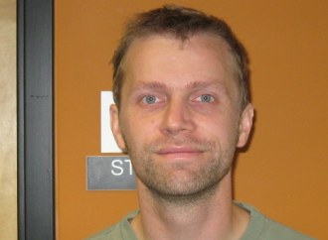
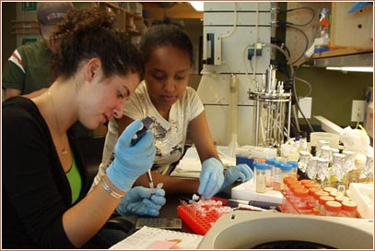
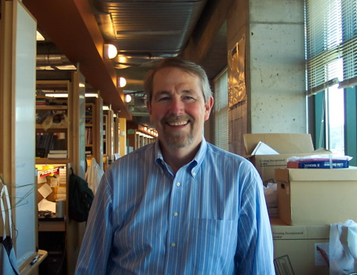
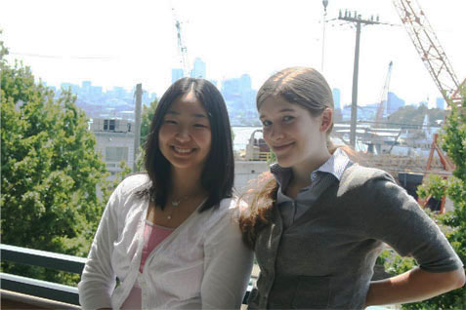
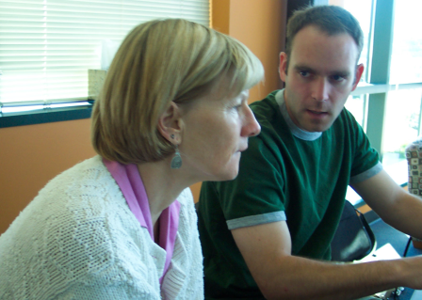
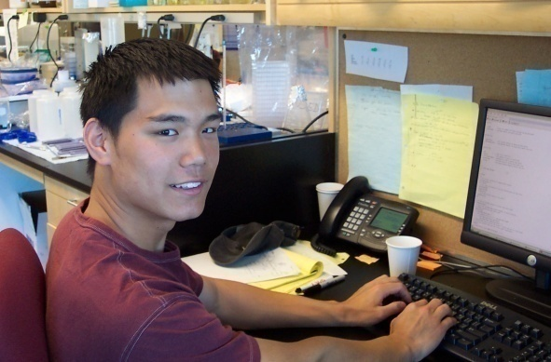
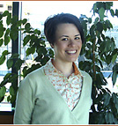
A spectacular collaboration!

Slide 12
NGSS Big Picture View
Notes:
HP Catalyst Academy, All Science and Engineering Practices
Asking questions (science) and defining problems (engineering)
Developing and using models
Planning and carrying out investigations
Analyzing and interpreting data
Using mathematics and computational thinking
Constructing explanations and designing solutions
Engaging in argument from evidence
Obtaining, evaluating, and communicating information
All Cross Cutting Concepts
Patterns
Cause and effect: mechanism and explanation
Scale, proportion, and quantity
Systems and systems models
Energy and matter: Flows, cycles, and conservation
Structure and function
Stability and change

Slide 13
ETS1: Engineering Design
ETS2: Links Among Engineering, Tech, Science & Society
ESS2: Earth’s Systems
ESS3: Earth & Human Activity
A: Defining an engineering problem
A: Earth’s Materials and Systems
A: Natural Resources
A: Interdependence of ST-M
C: Roles of Water in Earth’s surface Processes
B: Natural Hazards
B: Developing Possible Solutions
C: Human Impacts on Earth Science
B: Influence of Engineering, Tech, & Science on Society and the Natural World
C: Optimizing the Design Solution
E: Biogeology
PS4: Waves & Their Applications in Technologies for Information Transfer
LS2: Ecosystems: Interactions, Energy and Dynamics
B Cycles of Matters & Energy Transfer in Ecosystems
C: Information Tech & Instrumentation
LS4: Biological Evolution: Unity & Diversity
C: Ecosys Dynamics, Fxning & Resilience
B: Natural Selection
D: Social Interactions & Group Behavior
D: Biodiversity and Humans

Slide 14
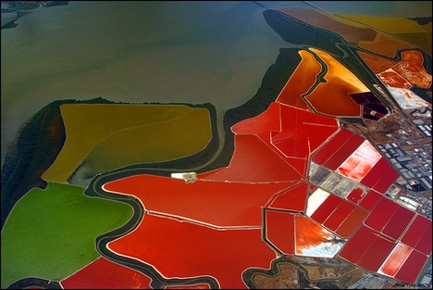
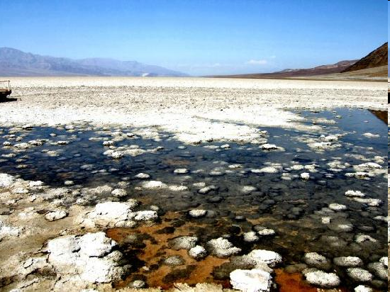
Observing Beyond our Senses: Inquiry Drives Technology
What happens when a scientist has a question that cannot be answered using current technologies?
Focus: the role of physics and engineering in the increasingly interdisciplinary field of systems biology; modeling science. Investigations in biological networks are advanced through improving technologies.
Class time: 3-5 weeks
Monitoring Death Valley’s Bad Water Middle Basin

Slide 15
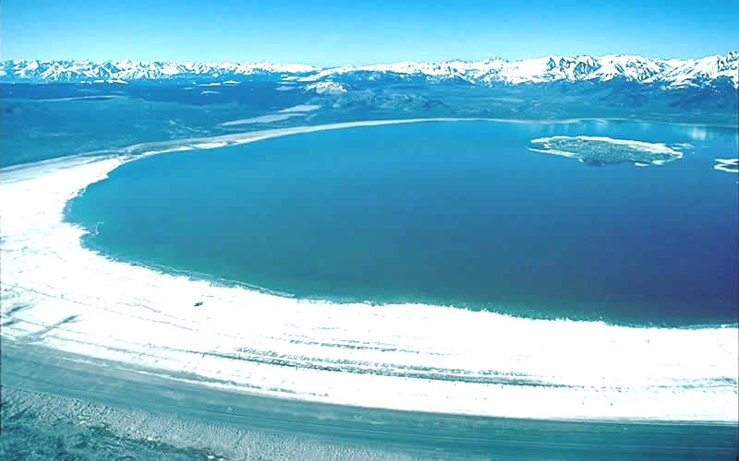
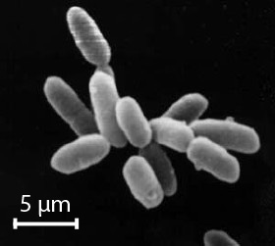
A consistent thematic narrative connects students to a real world problem...how do we accurately measure beyond what we can sense?
Notes:
Mono Lake, CA

Slide 16
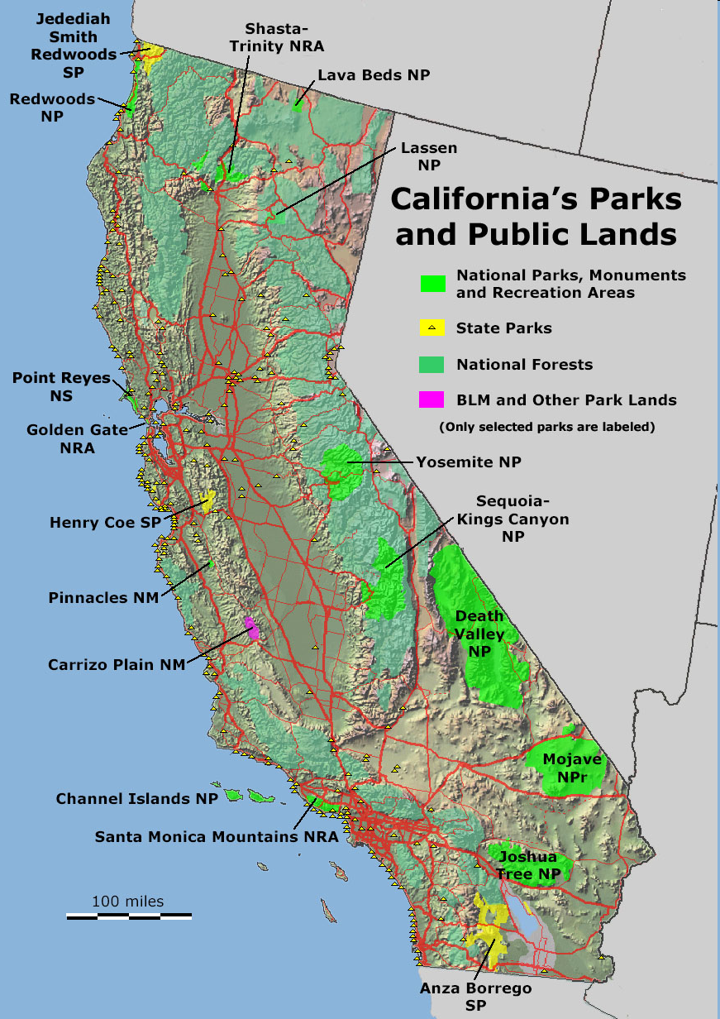
Death Valley Case Study
Develop a Water Management Plan for Death Valley’s Bad Water Middle Basin
Research In Situ Conditions by Studying Two Indicator Species: Extremophilic Microbes

Slide 17
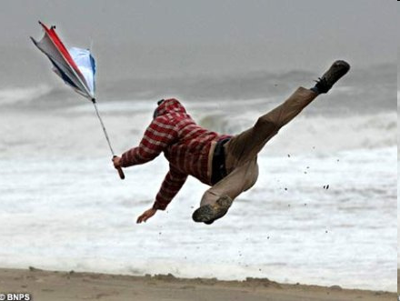
Design: An Iterative Process
Define the Problem Or Need
Identify Criteria & Restraints
Devise A Plan
Research
Brainstorm Solutions
Weigh Tradeoffs
Carry Out Best Approach
Evaluate & Refine
Test & Interpret Data
Recommend Improvements
Communicate Results
Notes:
When deciding on a method to measure wind speed, the importance of the application to define criteria related to precision and sampling rate for a measuring device is emphasized.

Slide 18
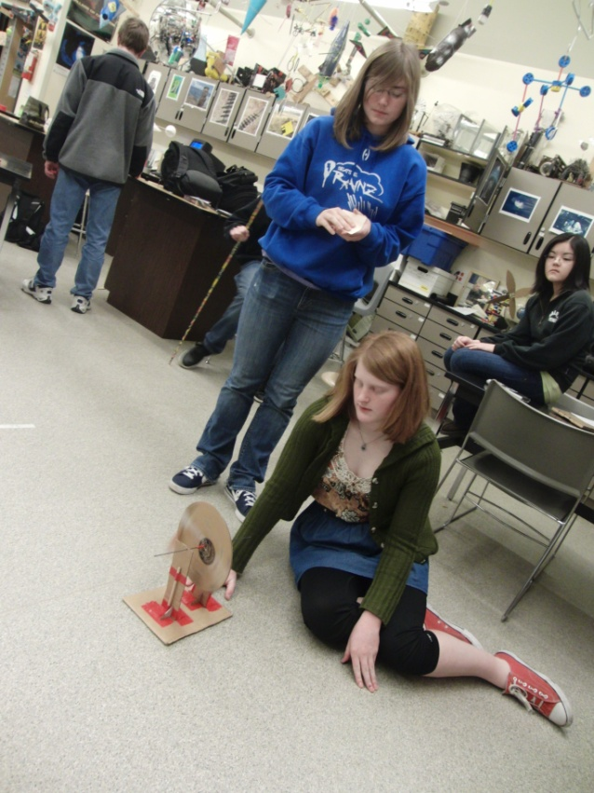
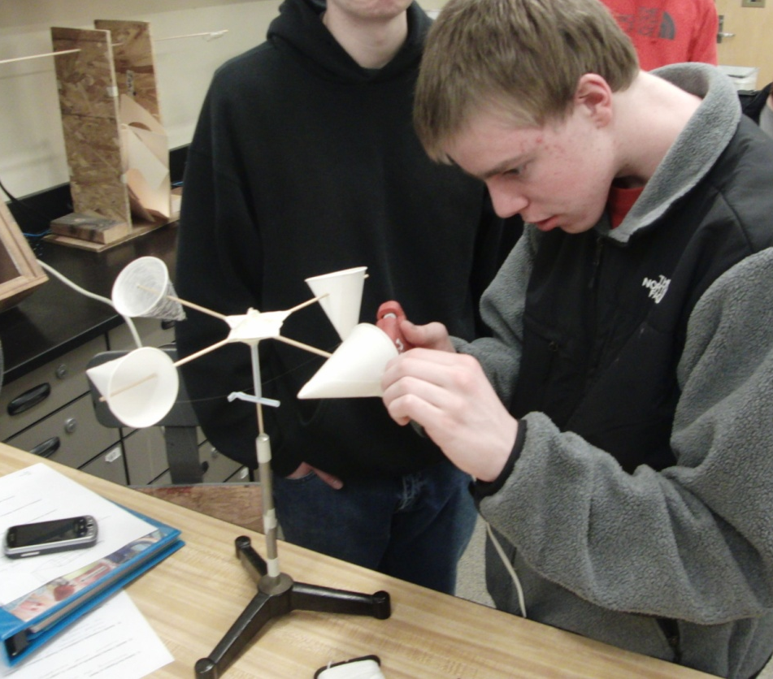
Students construct understanding by making and using their own scientific measuring instruments.

Slide 19
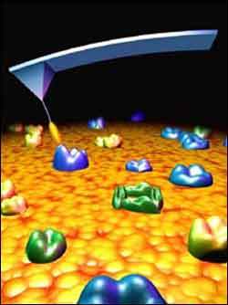
Mock Atomic Force Microscope: Inferences from proxy variable, exploration of issues of resolution and pattern prediction

Slide 20
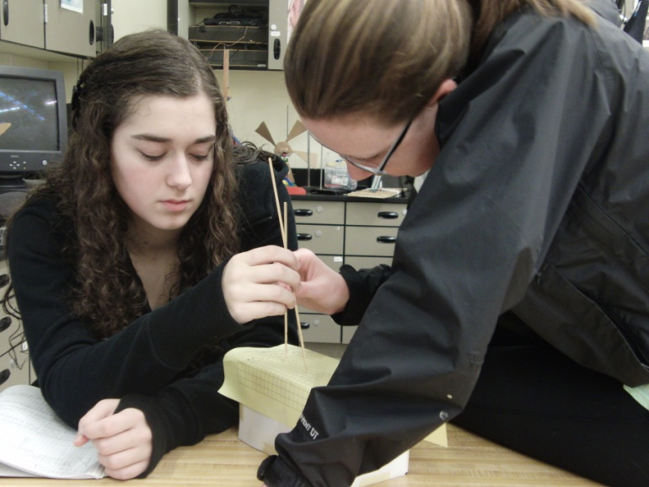
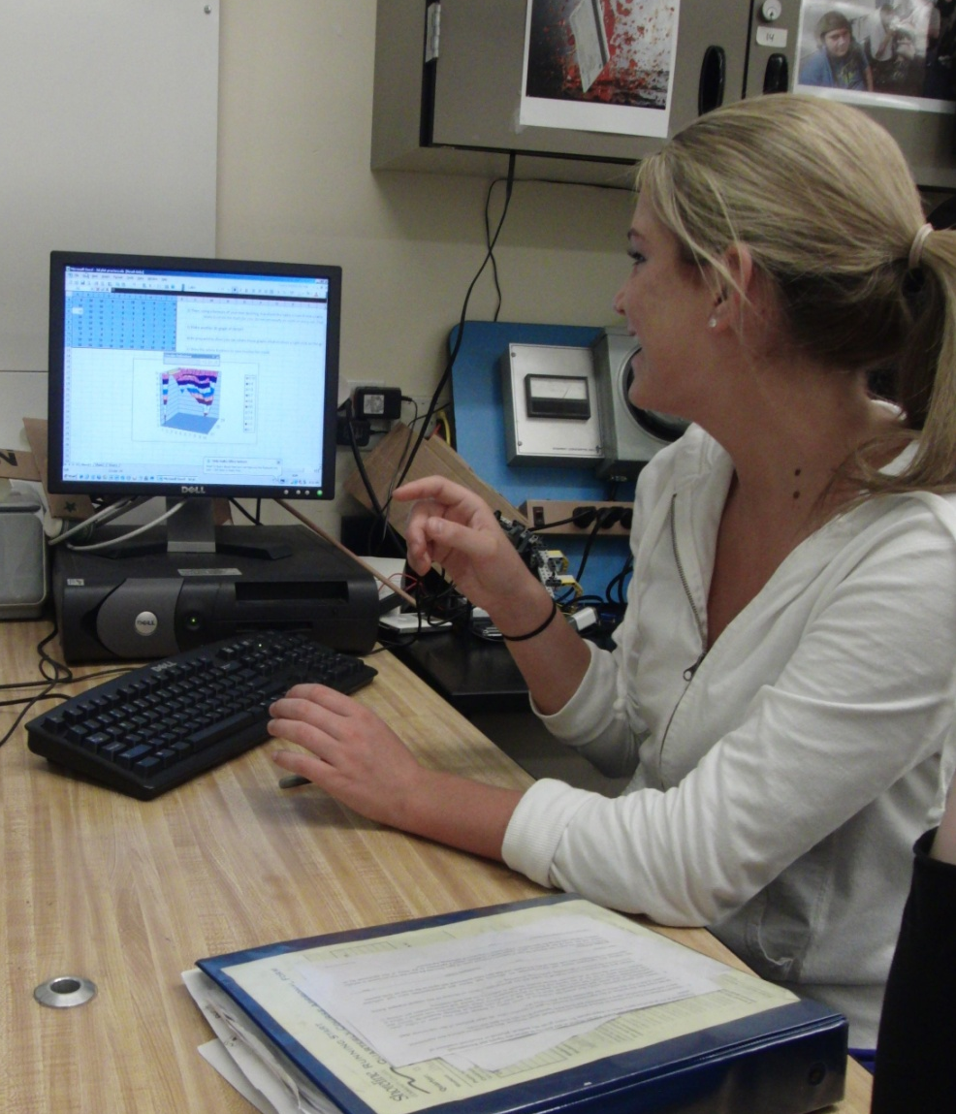
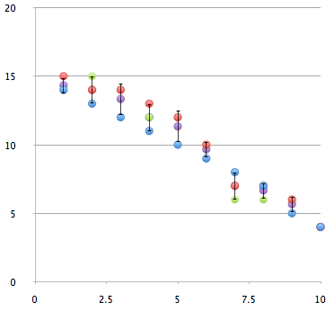
Students measure, graph and work with uncertainty.

Slide 21
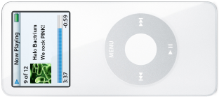
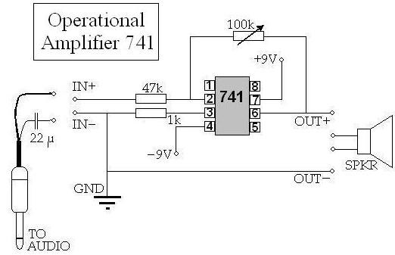
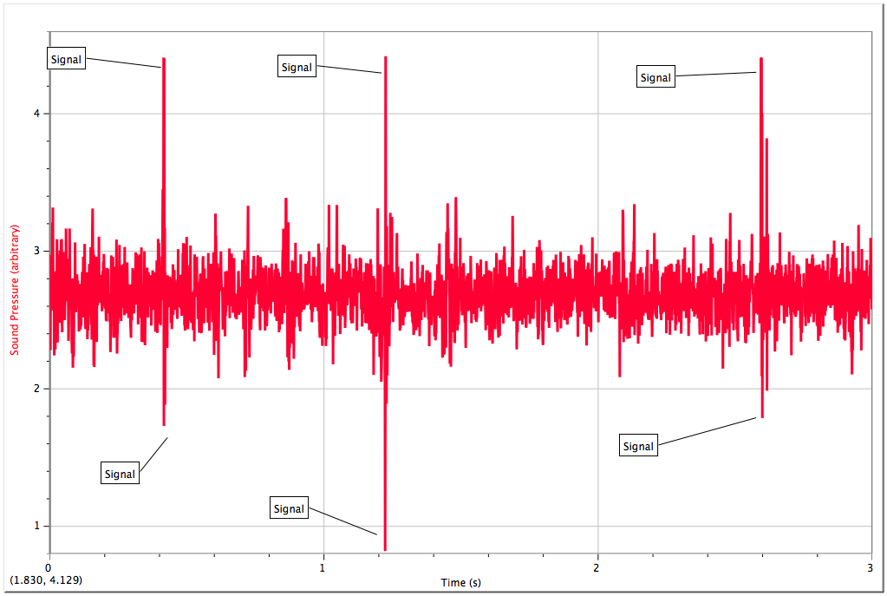
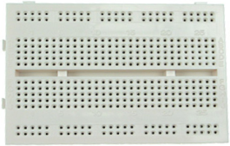
What are the trade offs and benefits of amplifying a signal?

Slide 22
Semaphore as a means to teach signal vs. noise

Slide 23
All of that’s through air – but what about our case study?
What other proxy variables exist? What might be useful?

Slide 24
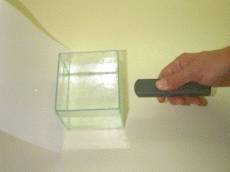
How can we use light as a quantifiable proxy variable?
How could we use the observed light properties to create an accurate measuring device?
How can we make this meaningful for population densities?
Notes:
For the final case study, students develop a sampling strategy based on limited resources to map the microbial population and infer point pollution sources. Their findings and recommendations are presented as a water management plan.

Slide 25
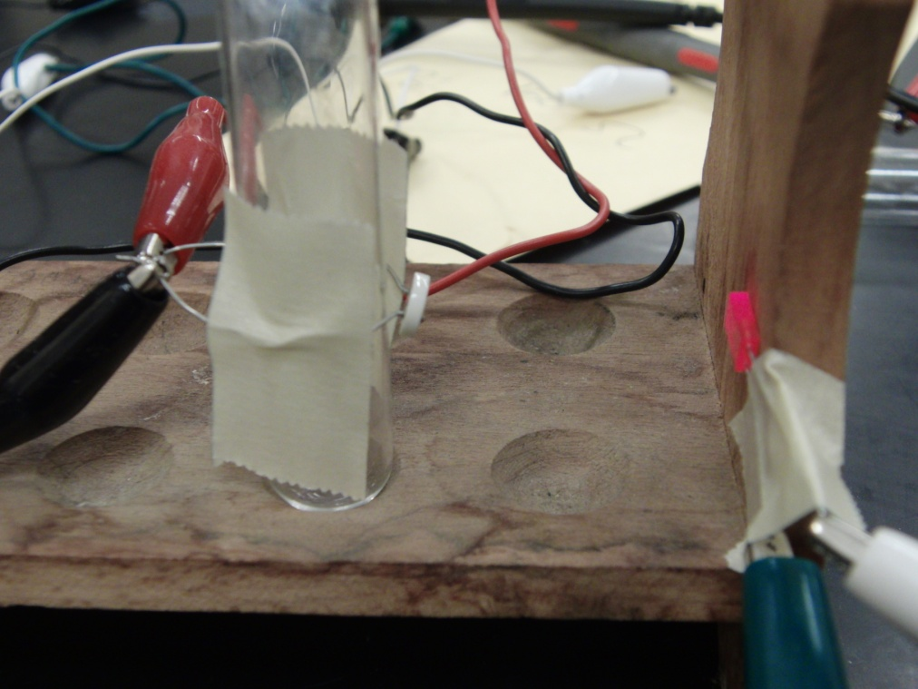
Students build and calibrate a simple electro-optical measuring device. Photoresistor LED light source Insert test tube with microorganism sample here

Slide 26
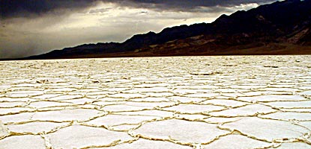
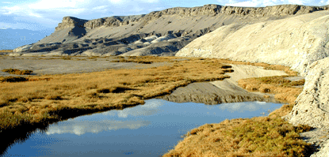
During the final project, students use an instrument they have made and calibrated to:
assess water quality
share data with their peers
determine the extremophile population density in samples from the test case area.
prepare a water management plan for a saline lake with unique extremophile microorganisms & a history of pollution.

Slide 27
Students collaborate to prepare graphical displays of their data
Case Study
Students collaborate to formulate a water management plan for a saline lake with unique extremophile microorganisms & a history of pollution.

Slide 28
Curriculum Website
www.systemsbiology.org
Education
Systems Education Experiences
see.systemsbiology.net
Modules
Observing Beyond our Senses: Inquiry Drives Technology
Old website: baliga.systemsbiology.net
Education

Slide 29
Questions?

Slide 30
Exploring 2 lessons
Observing Beyond Our Senses: Inquiry Drives Technology
Name of Lesson | Main Question Explored | Periods
1. Intro to Saline Environments & Halophiles | How can we count halophilic microbes? | 1
2. Design Process: Measuring Wind Speed | How do scientists and engineers design and evaluate solutions to measuring problems? | 2
3. Inferences from Proxy Variables: Mock Atomic Force Microscope | How do we count or measure things we cannot observe directly? | 2-3
4. Resolution and Noise: Operational Amplifiers | What are the trade-offs and benefits to amplifying a signal? | 2
5. Calibration and Inferring Properties from Light Behavior | How can we use light as a quantifiable proxy variable and how do we make our light measurements meaningful for population density? | 2
6. Case Study: Mapping Death Valley | How can we make inferences from microbe populations to develop a water management plan? | 2-4

Slide 31
Next steps:
Let us help you in any way we can.
Interested in summer program or field testing – contact me.
Do you see lessons such as these fitting in nicely with your current curriculum? Explore the modules at each station.
IF YOU ARE INTERESTED IN BEING A PART OF THIS PROCESS, PLEASE CONTACT CLAUDIA (CLUDWIG@SYSTEMSBIOLOGY.ORG, 206-732-1453).

Slide 32
Acknowledgements
Nitin Baliga
Chris Lausted
Baliga Lab
Institute for Systems Biology
National Science Foundation
All the teachers and students who have been involved - especially Brad Moore, Eric Muhs, Kim Sciarrone, Mari Herbert and our curriculum team…

