Slide 1




The Carbon Cycle
Oceans
Fossil Fuel Combustion
Terrestrial Plants
Fires
Algae /Aquatic Plants
Millions of years of heat and pressure
Fossil Fuels
Decomposition/Respiration

Slide 2
Photosynthesis and Carbon Cycling
Photosynthetic plants and algae remove carbon dioxide from the air and combine it with water to build sugar molecules and oxygen molecules.
When organisms decompose, the reaction is reversed. Carbon dioxide is re-emitted into the air.
CO₂
CO₂
In a natural system, growth and decomposition balance one another and the atmospheric carbon dioxide concentration remains fairly stable.
CO₂
CO₂
CO₂
CO₂
C₆ H₁₂ O₆
H₂O
H₂O
O₂
O₂
H₂O
O₂
O₂
H₂O
O₂
H₂O
O₂
H₂O
H₂O
CO₂
CO₂
H₂O
H₂O
H₂O
H₂O
Terrestrial Plants
CO₂
CO₂
CO₂
H₂O
CO₂
Algae /Aquatic Plants
Decomposition/Respiration

Slide 3
Photosynthesis and Carbon Cycling
CO₂
CO₂
In a natural system, growth and decomposition balance one another and the atmospheric carbon dioxide concentration remains fairly stable.
CO₂
CO₂
CO₂
CO₂
C₆ H₁₂ O₆
H₂O
H₂O
O₂
O₂
H₂O
O₂
O₂
H₂O
O₂
H₂O
O₂
H₂O
H₂O
CO₂
CO₂
H₂O
H₂O
H₂O
H₂O
Terrestrial Plants
CO₂
CO₂
CO₂
H₂O
CO₂
Algae /Aquatic Plants
Decaying Organic Matter
Decomposition/Respiration

Slide 4
Fossil Fuels and Carbon Cycling
CO₂
CO₂
CO₂
CO₂
CO₂
CO₂
CO₂
CO₂
CO₂
CO₂
CO₂
280 ppm
400 ppm
Pre-Industrial
Modern
Fossil Fuel Combustion
Terrestrial Plants
However, modern power stations, cars, and airplanes are releasing carbon that has been stored for millions of years in fossil fuel reserves. This disrupts the natural balance of the carbon cycle.
Algae /Aquatic Plants
Since the Industrial Revolution, the concentration of carbon dioxide has increased from 280 ppm (parts per million) to about 400 ppm.
Decomposition/Respiration

Slide 5
The Carbon Cycle: Overview
Oceans
Fossil Fuel Combustion
Terrestrial Plants
Fires
Algae /Aquatic Plants
Fossil Fuels
Decomposition/Respiration

Slide 6
Climate Change: Effects
Ocean Acidification
Sea Level Rise
Increasingly Severe Storms and Droughts
Changing Agricultural Patterns
Migration of Tropical Diseases Poleward
Changing Ocean Circulation Patterns

Slide 7
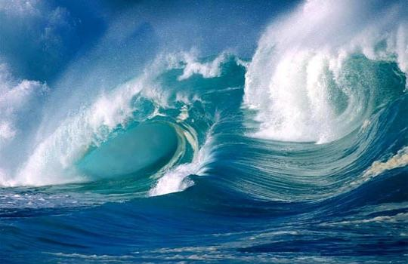
Ocean Acidification
The Carbon Cycle
Atmospheric carbon dioxide (CO₂ ) levels are rising
because of fossil fuel combustion.
The oceans uptake much of this CO₂
When the CO₂ dissolves, carbonic acid is formed
This acidification brings consequences for marine organisms and the system of which they are a part
Some organisms will be harmed; others may benefit
Notes:
Image source: http://www.thew2o.net/

Slide 8
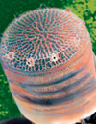
Case Study: Diatoms
Single-celled algae
Base of the marine food web
Fix 20% of carbon globally
A portion of diatom remains sink and, over millions of years, oil is formed from them
How will increased dissolved carbon dioxide affect diatoms’ ability to fix carbon? What does this mean for climate change?
Thalassiosira pseudonana
Notes:
Image: http://www.genomenewsnetwork.org/resources/sequenced_genomes/genome_guide_p4.shtml

