Slide 1
CO₂
CO₂
CO₂
CO₂
H₂O
CO₂
H₂O
H₂O
CO₂
H₂CO₃
H⁺
Wow, that’s a lot of chemical reactions! But how does this make the ocean acidic?
H⁺

Slide 2
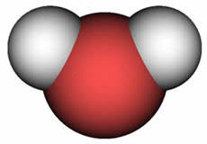
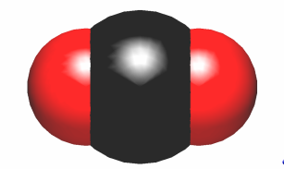

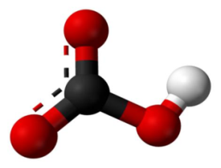
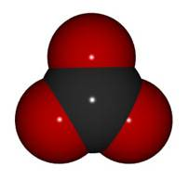
H₂O
Water
Carbon Dioxide
(atmospheric and aqueous)
CO₂
CO₂
H₂CO₃
Carbonic Acid
Bicarbonate ion
Carbonate ion
Notes:
Add names of molecules

Slide 3







pH review
How do we measure the acidity of the ocean?
pH measures acidity and basicity on a logarithmic scale ranging from 0 to 14
A solution with a pH of 7 is neutral,
greater than 7 is basic,
and less than 7 is acidic.
What else can you add to the pH scale?
We’ll do some experiments in the lab testing pH.
ACIDIC
BASIC
NEUTRAL

Slide 4
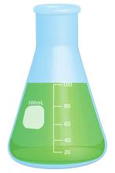
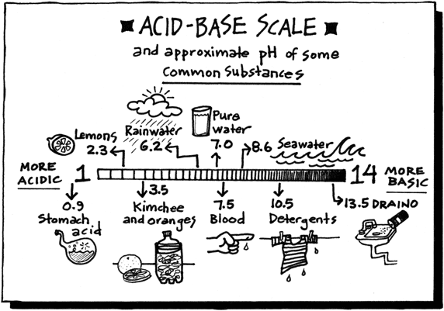
pH chemistry
On a chemical level, pH estimates the concentration of hydrogen ions in the solution.
The pH of a solution is equal to the negative log of the hydrogen ion concentration in the solution,
pH = - log[H⁺]
Because this is a negative relationship, an increase in hydrogen ions means a decrease in pH or that the solution is becoming more acidic.
So a decrease in the pH of the ocean indicates an increase in the hydrogen ion concentration. Lets go back to the carbonate system to understand how carbon dioxide increases the hydrogen ion concentration in the ocean.
.
H⁺
H⁺
H⁺
H⁺
H⁺
H⁺
H⁺
H⁺
H⁺
H⁺
H⁺

Slide 5
CO₂
CO₂
When carbon dioxide dissolves into the water it can combine with a water molecule to form carbonic acid.
Carbonic acid then dissociates into a bicarbonate ion and a hydrogen ion.
Bicarbonate ions can also dissociate, releasing another hydrogen ion, further decreasing the pH.
CO₂
CO₂
H₂O
CO₂
H₂O
H₂O
CO₂
H₂CO₃
H⁺
H⁺
Notes:
Every time one carbon dioxide molecule combines with a water molecule
Looking back at the carbonate system, there is the potential for two hydrogens to form for each water/ carbon dioxide combination. What will happen to the pH with the addition of each hydrogen ion? That’s right as carbonic acid dissociates, the hydrogen ion will make the water more acidic.

Slide 6
How much has the Ocean’s pH really changed?
MarineCalcifyingOrganisms
Dr.Orellana
Dr.MonicaOrellana
Lets chat online with researcher, Dr. Monica Orellana to find out exactly how much the ocean pH has already changed!
Dr.Orellana: Hello, marine calcifying organisms! I understand you have some questions about the state of your ocean.
MarineCalcifyingOrganisms: Yes, Dr. Orellana! Thank you for chatting with us! Could you tell us how much the pH of the ocean has already changed?
Dr.Orellana: Great question. The pH of the ocean before the industrial revolution was 8.2. Currently the pH is 8.1 on average and by the end of the century it is expected to be 7.8.
MarineCalcifyingOrganisms: That does not sound like a very big change!
Dr.Orellana: Well, because pH is measured on a logarithmic scale, the difference between each unit on the pH scale is a tenfold change in hydrogen ion concentration.
So when we say that the pH of the ocean has decreased by 0.11, we really mean to say it is about a 30% increase in hydrogen ion concentration!
MarineCalcifyingOrganisms: Wow! I didn’t realize the ocean was already becoming so acidic! Thank you for the information Dr. Orellana!
Yes, Dr. Orellana! Thank you for chatting with us! Could you tell us how much the pH of the ocean has already changed?
That does not sound like a very big change!
Wow! I didn’t realize the ocean was already becoming so acidic! Thank you for the information Dr. Orellana!

