Slide 1
Planning a Cohesive Set of Experiments
Ocean Acidification: A Systems Approach to a Global Problem
Lesson 4

Slide 2
Warm up:
How is ocean acidification a global problem?
Is OA a situation that requires a systems study? Why or why not?
What do you think systems thinking is?

Slide 3
Systems Thinking!
In order to understand this complex situation, we’ll need to understand the many parts and players, their relationships, and how they all work together.
This sounds like a job for…
Let’s break those words down
Starting with the easy one: What is “thinking”?
What is a system?

Slide 4
Various things are listed below. Put an X in front of the things that can be thought of as a system.
 | Aquarium |  | Digestion |  | Cell phone
 | Pile of sand |  | Food web |  | A + B = C
 | Earth |  | Hurricane |  | Electrical circuit
 | Grasshopper |  | Graph |  | Water cycle
 | Volcano |  | Seed |  | Human body
 | Soil |  | Bicycle |  | Density = Mass ÷ Volume
 | Ocean |  | Earth and its Moon |  | Box of nails
Explain your thinking. How did you decide whether something is considered to be a system?
From Paige Keeley’s Physical Science and Unifying Themes Assessment Probes – Uncovering Student Ideas in Science p. 81

Slide 5
How are good habits formed?
Notes:
To equip our students with the skills necessary to make the tough decision of the future, we need them to instill the habits of a systems thinker. This will help in science and life. Systems thinking can become a useful habit and enables behavioral change. At the end of this unit, we’ll come back to this list of habits and see what we completed that helped instill these useful habits.

Slide 6
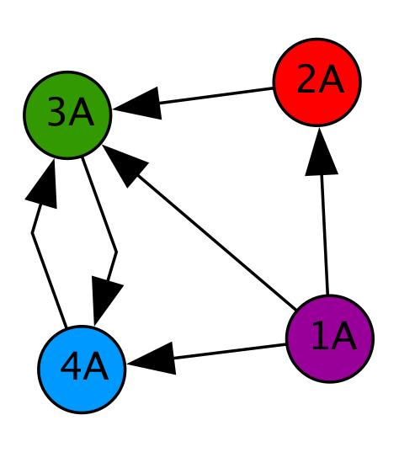
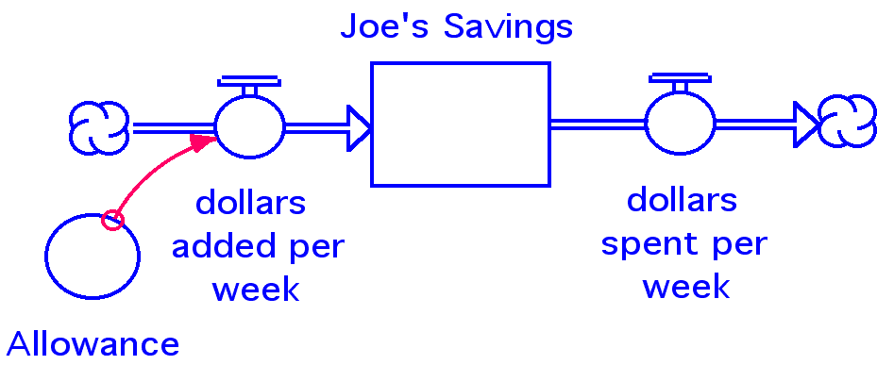
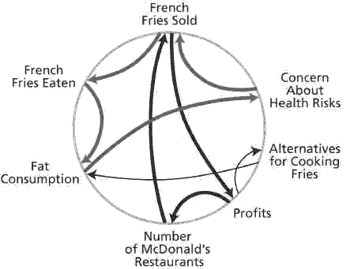
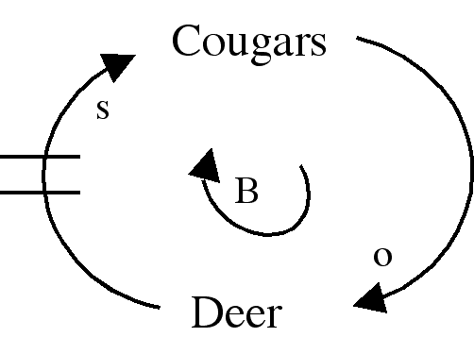
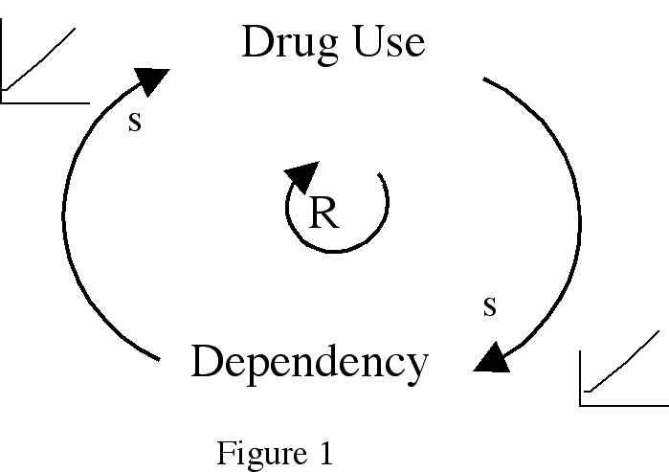
What are the tools of the trade for systems thinking?
Network Diagram
Stock/Flow Diagrams
Causal Loop Diagrams
Connection Circle
See www.watersfoundation.org for more on these tools

Slide 7
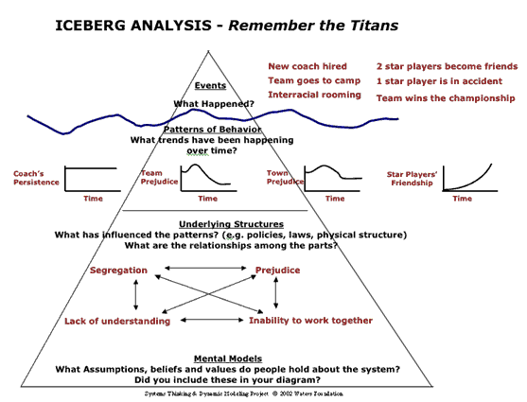
See www.watersfoundation.org for more on these tools
More Tools – Behavior Over Time Graphs and Iceberg Model. Tools are often used together. The Iceberg Model allows us to see what mental models are at the root of the problem.
Behavior over time Graphs

Slide 8
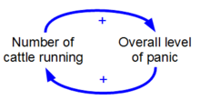
Balancing vs. Reinforcing loops
Do you think this is a balancing or a reinforcing loop?
What about the CO₂ loop in our environment?
How can we learn more?

Slide 9
Partial Carbon Cycle Review
Ocean Plants such as Phytoplankton
(photosynthesis)
Trees and Plants (photosynthesis)
?
Combustion Reactions
Ocean Organisms such as oysters (respiration)
Animals (respiration)
Where should we add our “s” for same direction or “o” for moving in the opposite direction. Can we use “+” and “-” in this case?
What balances the Combustion Reactions?
Notes:
The important thing for students to see is that for many years this situation was balanced. However, now with increasing combustion reactions what is the counterpart to all of that CO2? The ocean? Is that a good thing or a bad thing? Do we have all the answers? (no) Can we study this in our class with our resources? (yes!)

Slide 10
Working together to understand CO₂, ocean acidification and its implications.
We have:
our interest groups,
some basic science understanding,
and we are developing the systems skills to experiment and analyze complex situations.
We will:
practice collaborative research by each doing our part to understand this system.

Slide 11
Main question: What effect does the increasing atmospheric CO₂ have on the ocean and its subsystems?
1). In your group - Brainstorm!
2). Refine the question – narrow it. Make it interesting and applicable to your interest group.
3). This should lead to your hypothesis which should focus on your prediction and the measures that will tell you if your hypothesis is supported or not.
4). This should lead to your roughly outlined procedure. Complete a procedural flow chart and a list of all materials needed for your experiment.
5). Discuss and hand all of this in for approval. Remember we need our class to complete a cohesive set of experiments – you may need to alter yours slightly to complement instead of replicate someone else’s experiment.

Slide 12
To hand in today
Main Question
Your Question (should connect specifically to your interest group & subsystem)
What measurements will you collect?
What is your prediction?
Hypothesis
Procedure
Materials

Slide 13
Just in case reminders are needed the next slides contain
A list of the interest groups
Possible experimental considerations

Slide 14
At the end of this unit, you will present as a delegate for one of the following groups at the “International Convention on the Impacts of the Changing Carbon Cycle on Ocean Systems”:
Populations that rely on using, creating, and/or emitting a great deal of CO₂
Island Nations and populations which largely depend on their pristine environment for fisheries and ecosystem services that will be threatened by ocean acidification
Marine calcifying organisms which are predicted to suffer dramatically
Marine photosynthesizing organisms, specifically diatoms, which may play a role in CO₂ sequestering and will likely increase growth in a high CO₂ environment

Slide 15
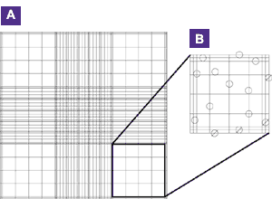
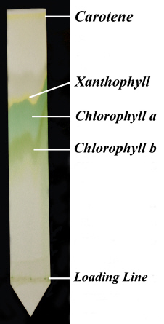
Systems Studies need for multiple & diverse data
What sort of data will you be able to gather?
Cell counts using a slide or hemocytometer?
Cell counts using a spectrophotometer or fluorometer?
pH measurements using indicators, test strips, electronic probes?
Temperature readings? Light meters?
Pigment description
Pigment extraction through chromatography?
Chromatogram from Henderson State Univ. http://198.16.16.43/content.aspx?id=7261

Slide 16
There are many slight variations in experimental procedures that could lead to interesting results
Water type
Marine water vs. freshwater
From aquarium, collected from environment, artificially made in a lab, filtered or not filtered
Various nutrient levels within water
Nitrogen, phosphorous, and silica types and amounts
Salinity levels
Temperature
pH
Amount of light, timing of light
Organisms and/or type of shell
CO₂ source

Slide 17
What source of CO₂ will you use?
Respired by you or yeast or some other organism?
Through combustion of coal, wood, or some other substance?
Through chemical reactions such as baking soda and vinegar?
Through dry ice?
Through what already exists in equilibrium with our classroom air and water?
Through some commercially available product such as soda, alka seltzer, etc.?
How will you transfer the CO₂ from its source to your experimental solution?
What safety precautions will you take?

Slide 18
Last reminders…
Everyone will also have some sort of online data component to supplement your experiment - more on that soon.
Remember to write everything down! You will be responsible for presenting this at a final summit, so you must begin preparing now by keeping accurate records.
Have fun!

