Slide 1
Amplifying Signals
Breadboarding:
from a diagram to an actual working amplifier.

Slide 2
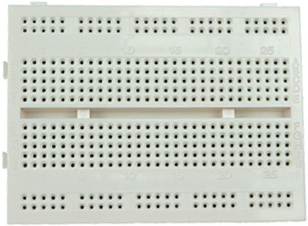
Breadboard connections?
Each block of 5 sockets or “holes” have common wires underneath
The power rails are connected all the way across the row

Slide 3
Breadboard connections:
How about these sets of wires?
These are now connected
?
NOT
These are now connected
?
NOT
These are
connected
?
NOT
Yes
Common wires underneath means…

Slide 4
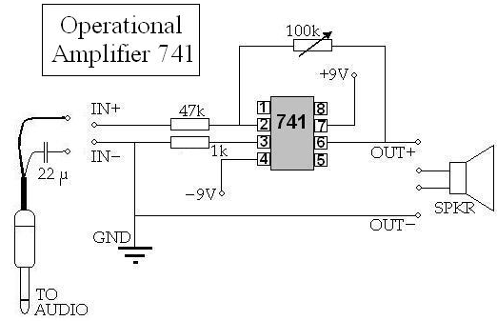
This is a diagram of an amplifier circuit. We could just connect these wires, but using a breadboard is easier…

Slide 5
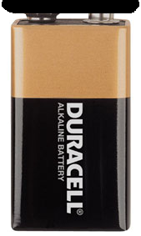




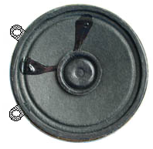

+9 V
Power supply
Variable Resistor
audio input
GROUND
output to speaker
8 7 6 5
1 2 3 4
- Terminal
+ Terminal
Power supply
–9 V

